Slide 1




Dorsal Pulvinar Contributions to Reaches and Saccades
Nikhil Yadav
IMPRS Neuroscience
(Lab Rotation 3)

Slide 2
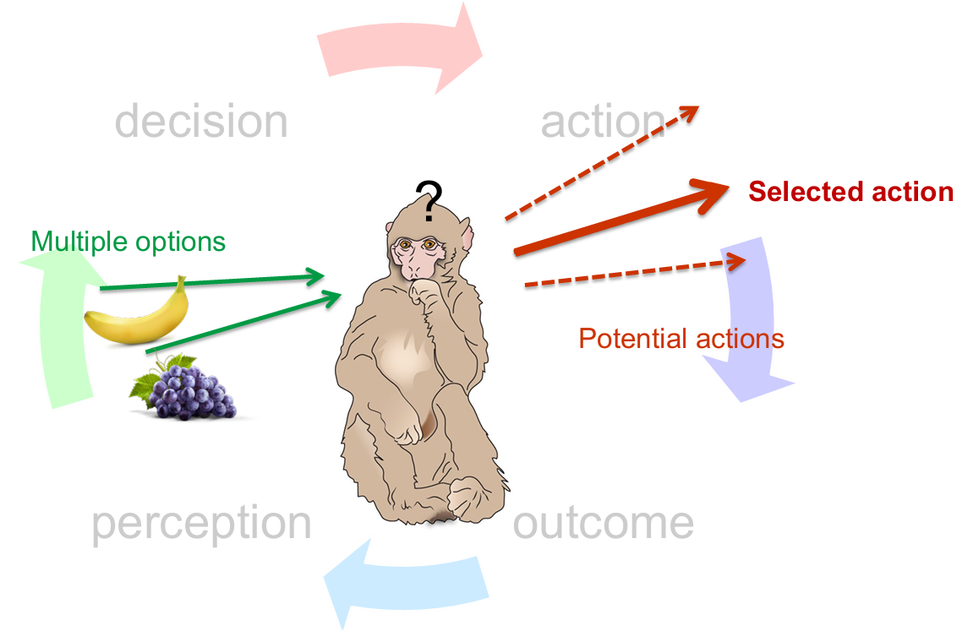
Sensorimotor Transformation
Decision
Action
Goals/Rewards/
Motivations/Predictions
Perception
Outcome
Notes:
To slowly orient ourselves, we are in realm of sensorimotor transformations.
An animal has to continuously perceive, make decisions and act all in parallel.
Multiple goals and motivations compete to give us a final action outcome.
Our language of course hides the complexity of these processes in terms of neural circuitry.

Slide 3
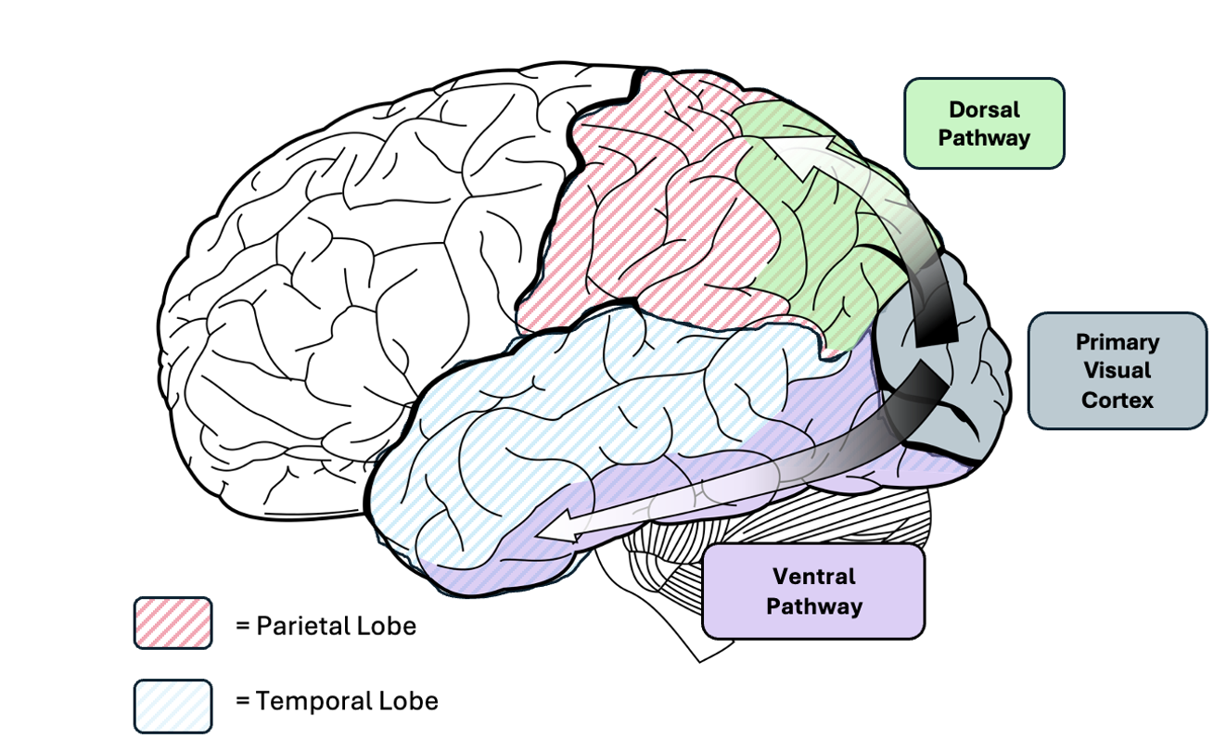
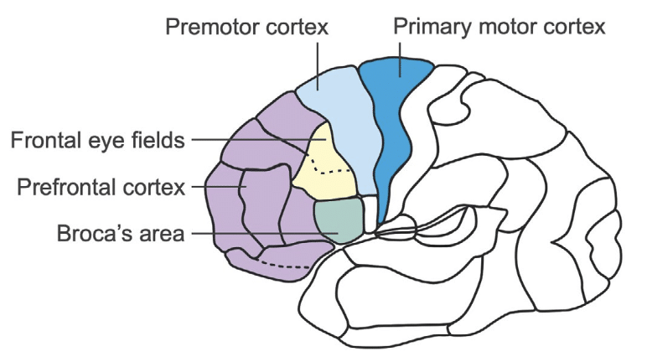
Brain regions for Saccades and Hand Reaches
The dorsal “WHERE/HOW” pathway (1)
The frontal motor regions (2)
Posterior Parietal Cortex: Localising visual information
In a proprioceptive body-centred world for action
Frontal eye fields and premotor cortex
Subcortical: Superior Colliculus
Notes:
So we start by looking at some of the brain regions associated with these processes.
Here we have the dorsal pathway that is thought to localize things in the visual space. Where things are in relation to our body.
On the right, we have the these motor regions that have to compute and implement action trajectories.
Frontal eye fields are related to saccades and the motor cortex for reaches.

Slide 4
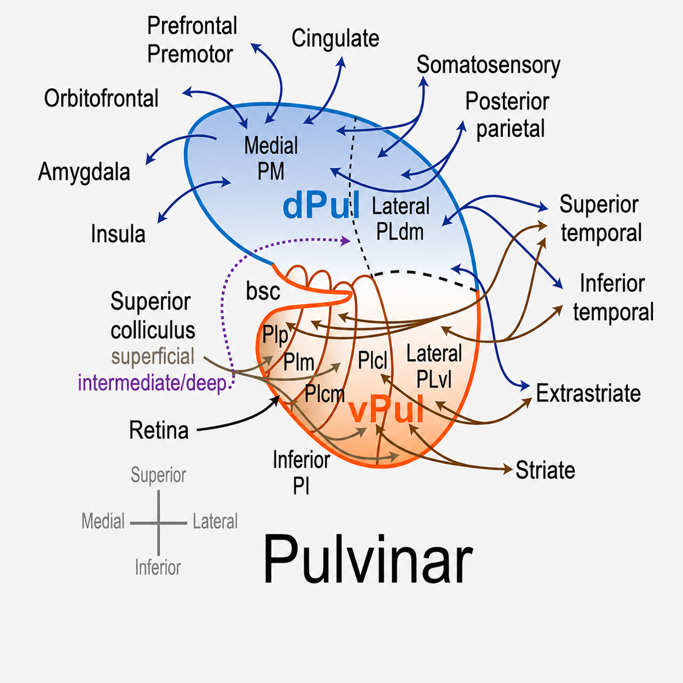
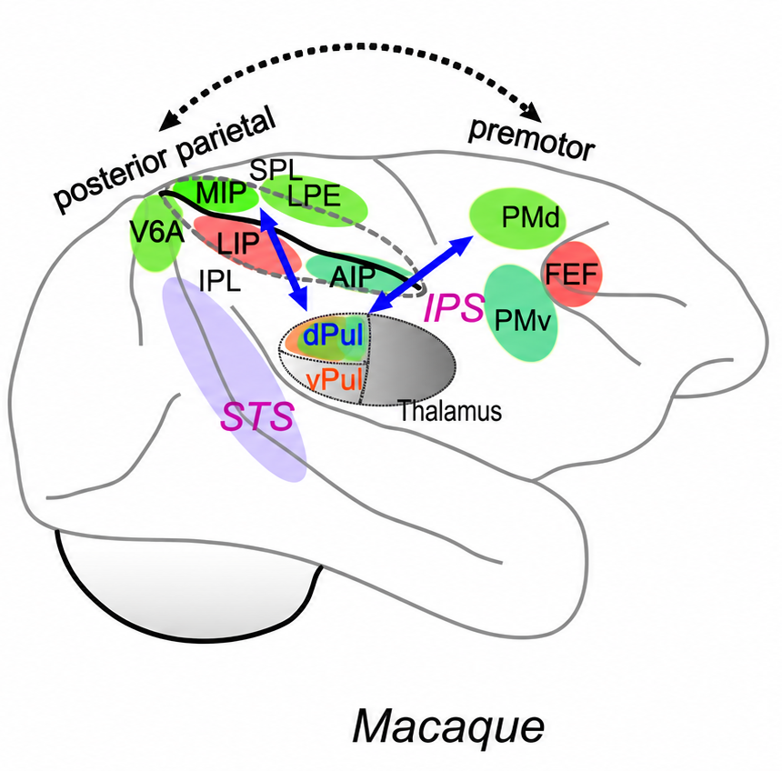
Situating the Pulvinar: Subdivisions and connectivity
Largest thalamic nucleus in the primate brain, Higher-order nucleus with multiple subnuclei
Hub for spatial attention, target selection, and coordination of visual networks
Dorsal Pulvinar connects bidirectionally with saccade and reach regions
Red: Saccades
Green: Reaches
Ref: (3)
Notes:
Where does the Pulvinar come in?
It is the largest nucleus within the primate thalamus. With many subregions, it connects to different parts of the cortex.
It has been related to spatial attention and coordinating visual networks, but we are still not sure what is its function in those networks
It is heavily connected to the regions implicated in saccades and reaches. This makes it a very relevant region to study. To understand what it could be doing and what not.

Slide 5

Experimental Setup
Monkey sits in front of screen, eye tracker + electrodes
1.3 s
Either the arm or the eyes move, not both
1.3 s
Cued effector and target location
Movement
Fixation Dot
Eyes + Arm
Notes:
For the experiments,
The monkey sits in front of a screen, and has to both fixate with the eyes at the centre and also put one of the hand there.
When the fixation is present for some time, the CUE comes in. The color tells the monkey what to use, the hands or eyes to reach the target.
The target is present in the peripheral space.
After a delay period of 1.3 seconds, the central dot vanishes which is the GO signal for the movement.
Either the arm or the eyes move, not both

Slide 6
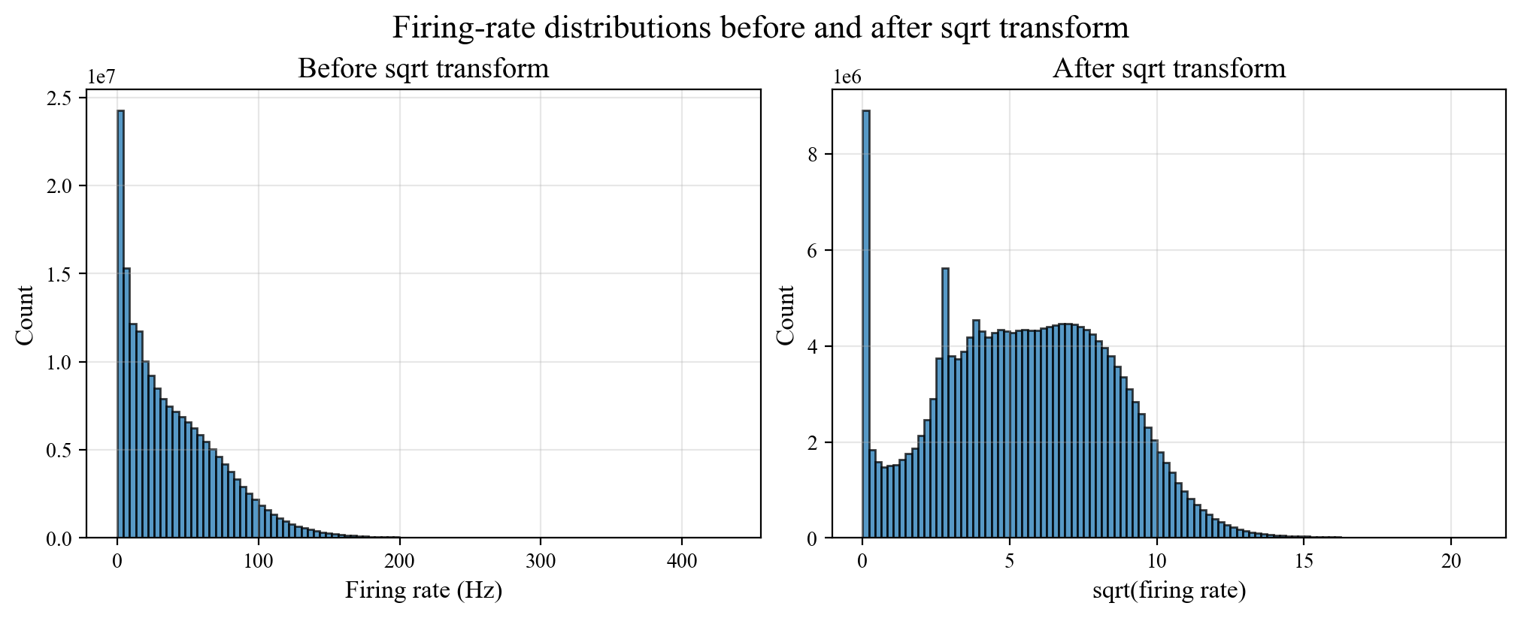
Basic preprocessing steps
Data from two monkeys F and L. Only data from F is shown.
Neurons/Units: 201
Number of total trials: 38,845
Converting spikes to firing rates with convolution. Activity centred around the CUE (-500 ms to 2000 ms)
Square root transformation (4)
Firing rates are Poisson distributed, variance (and noise) proportional to mean
Take square root to stabilize across units
Notes:
We got the data from two monkeys. Only one of them is shown having 200 units and lots of trials.
We converted spikes to firing rates and we only analyse those in a certain window around the CUE signal.
This is what you’ll see later in the plots.
Next we do a commonly employed square root transformation of firing rates.
But we still face a problem for analysis called mixed selectivity.

Slide 7
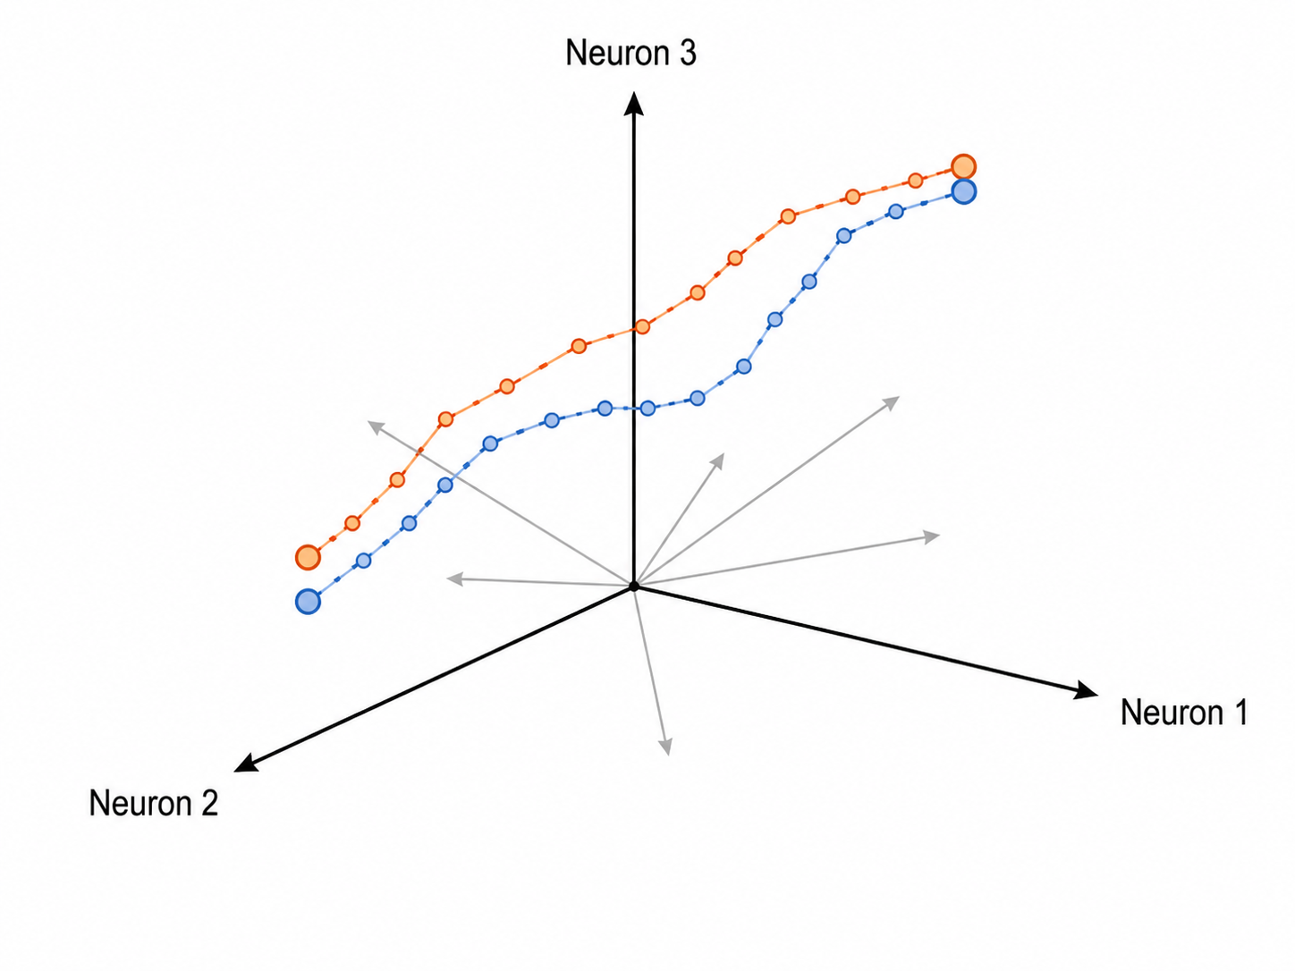
Mixed Selectivity
A neuron shows mixed selectivity if it responds to multiple independent task variables.
This makes interpreting single neuron responses very difficult
Is this neuron encoding space? Effector? Hand? Cue? Movement? An interaction?
Typical for higher and frontal areas
Another problem: Single-neuron firing shows trial-to-trial variability, so one neuron may not give a reliable readout of the task variable.
Population Analysis
Advantage? Actions must be very flexible, hence a regions activity is very high dimensional. This is beneficial for downstream neurons that can more easily choose a specific dimension.
Ref: (5), (6), (7)
Notes:
What does that mean? A neuron shows mixed selectivity if it responds to multiple task variables.
That means it is very difficult to assign a clean meaning to these neurons like we do in V1 with oriented bars.
Another problem we face is of very high trial-to-trial variability for the same task.
To overcome these, researchers do population level analysis.
There are certain advantages to this we can discuss later.

Slide 8
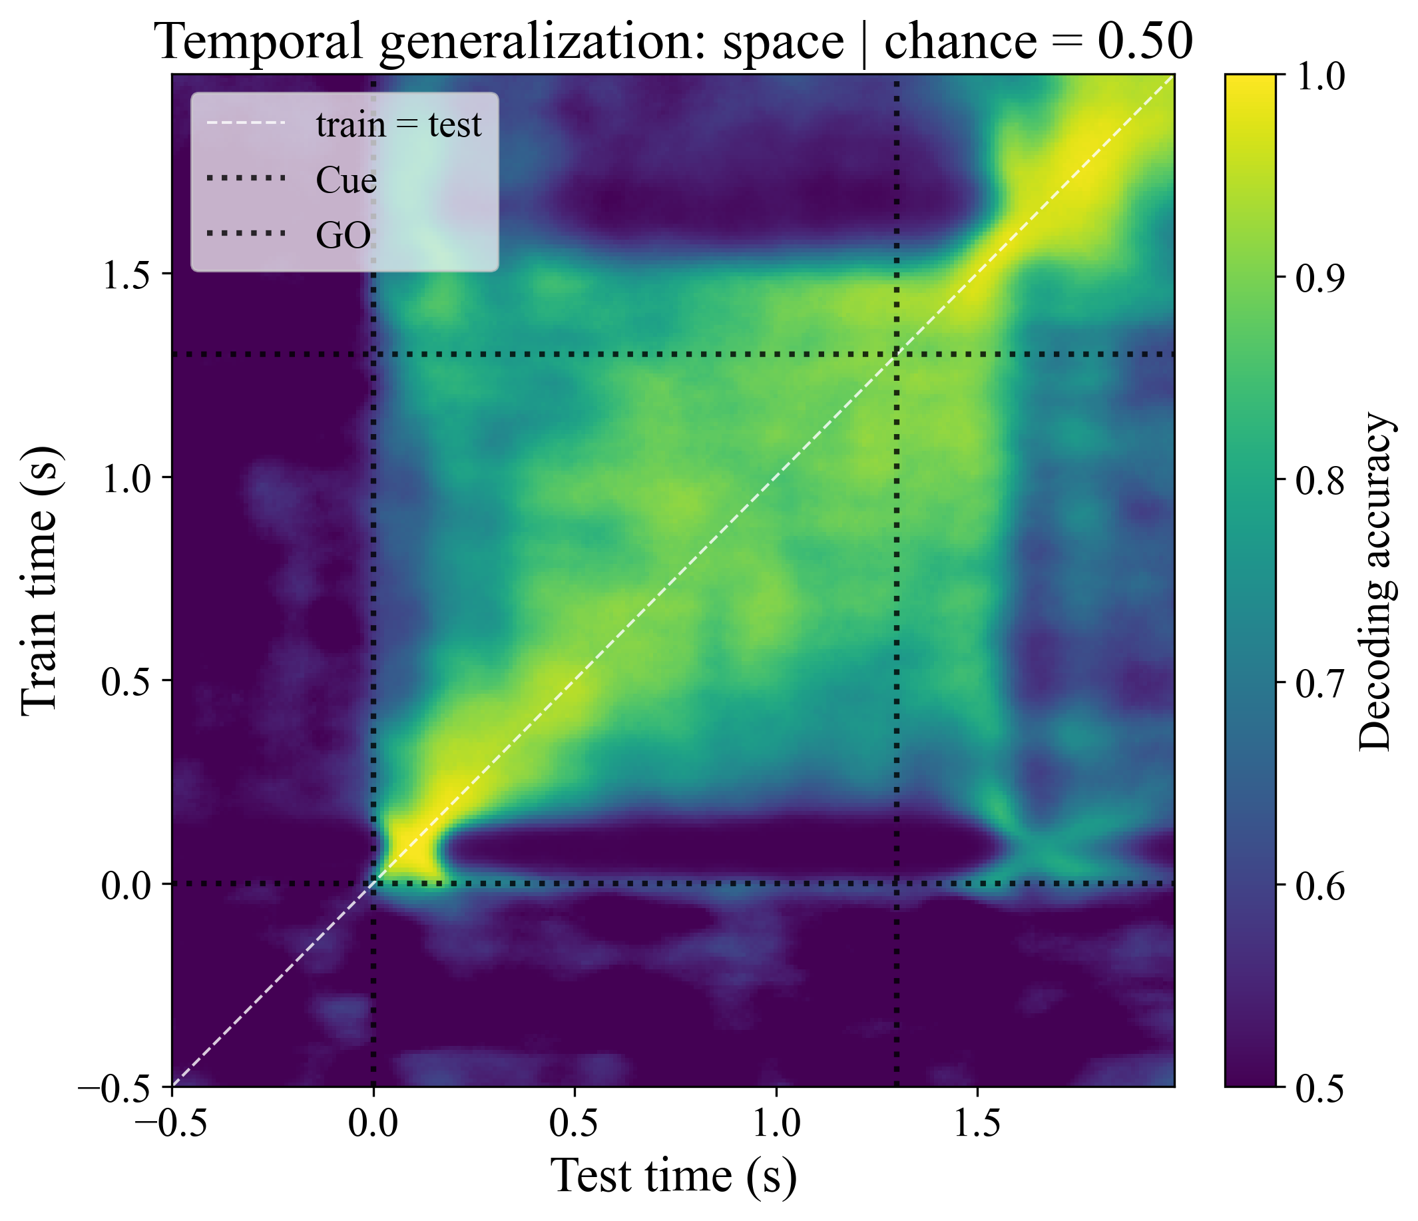
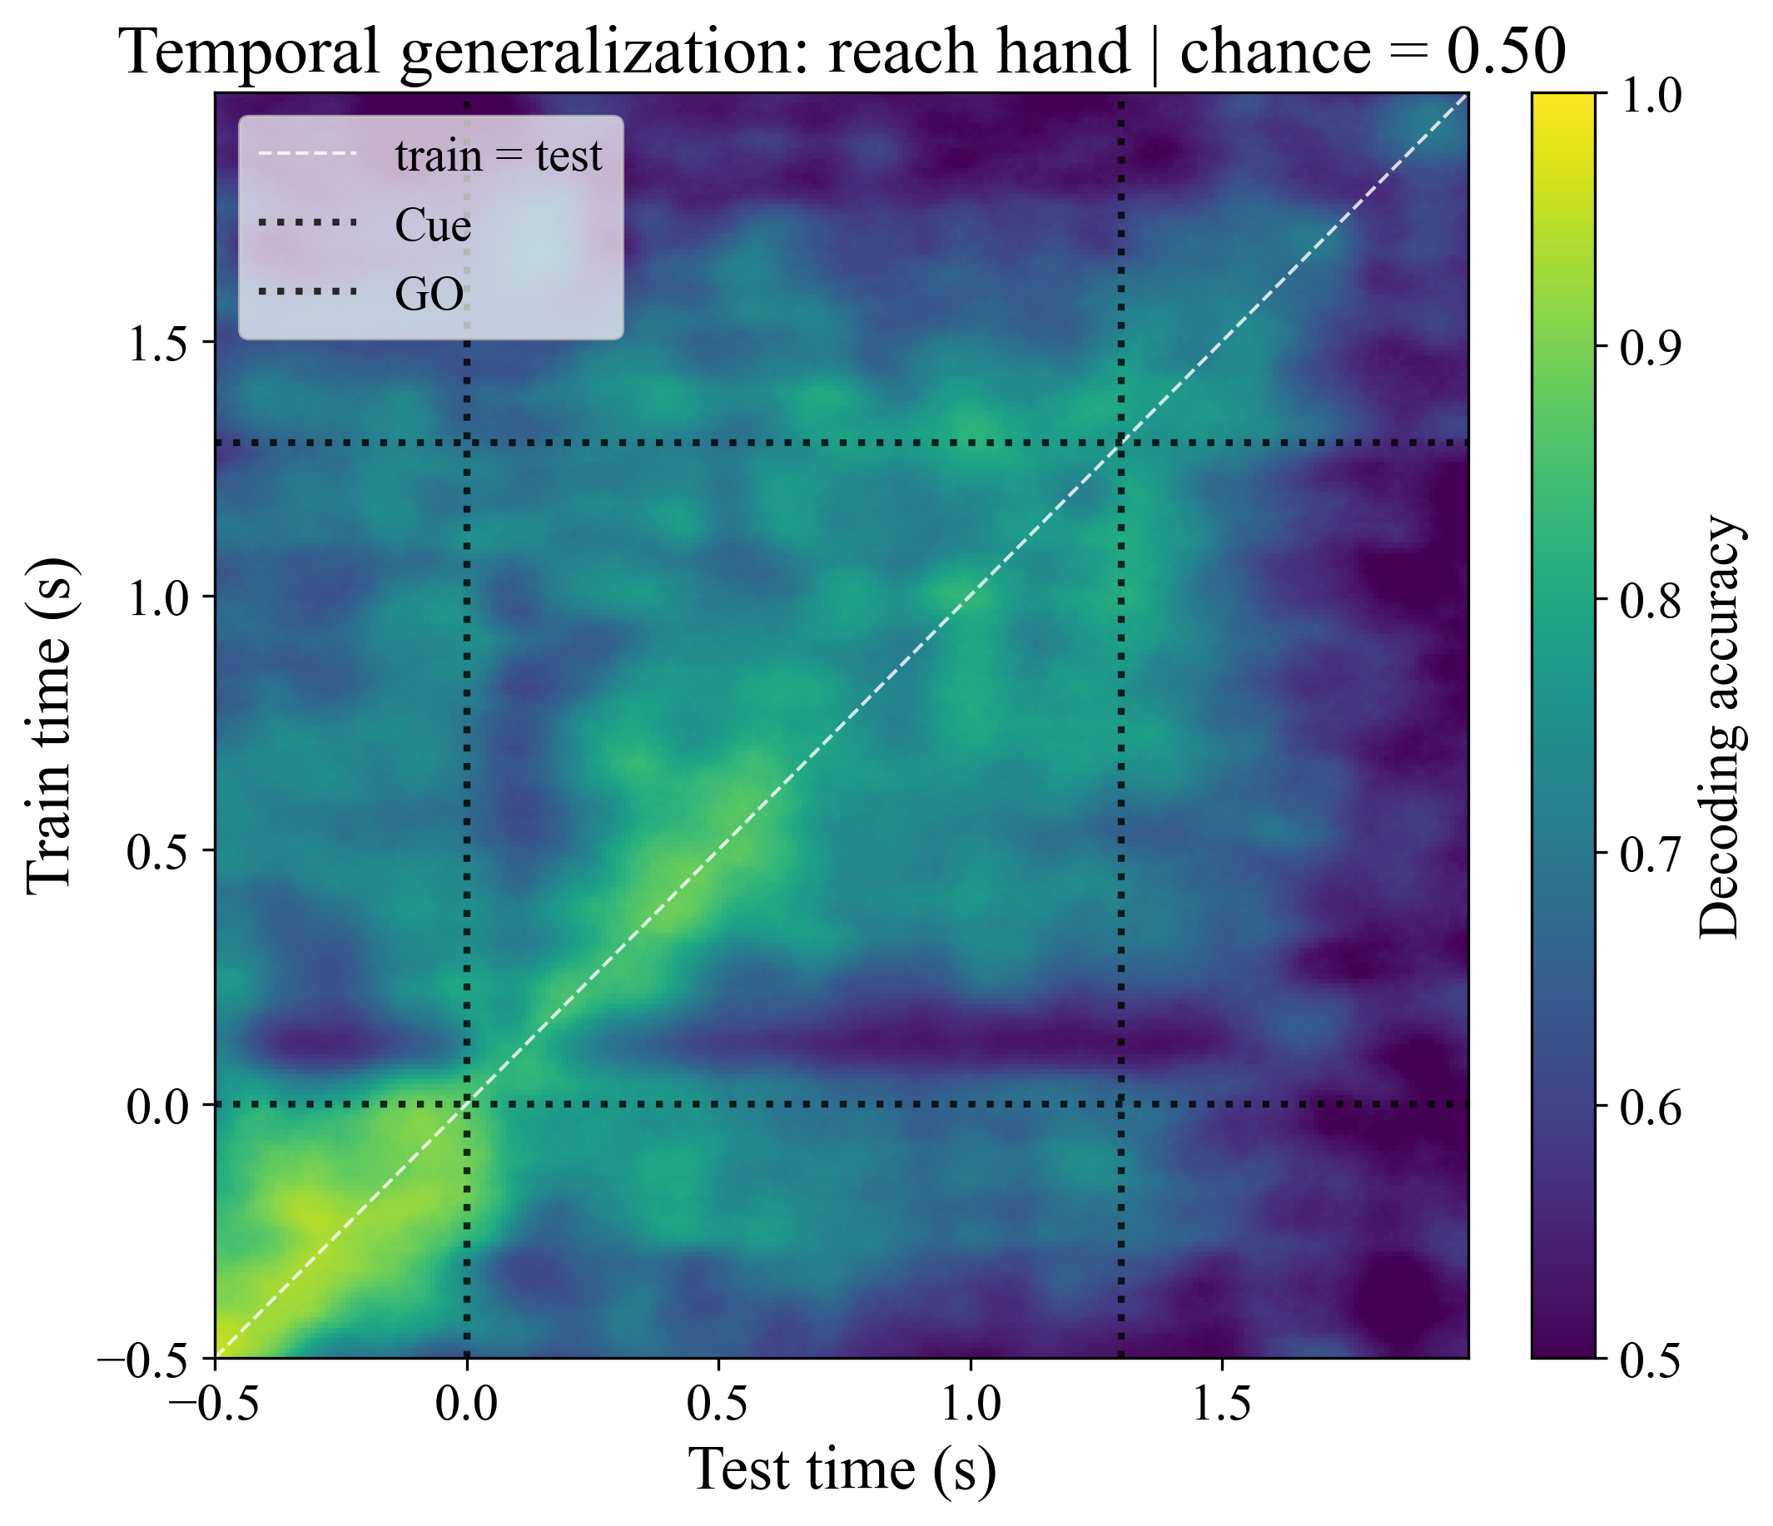
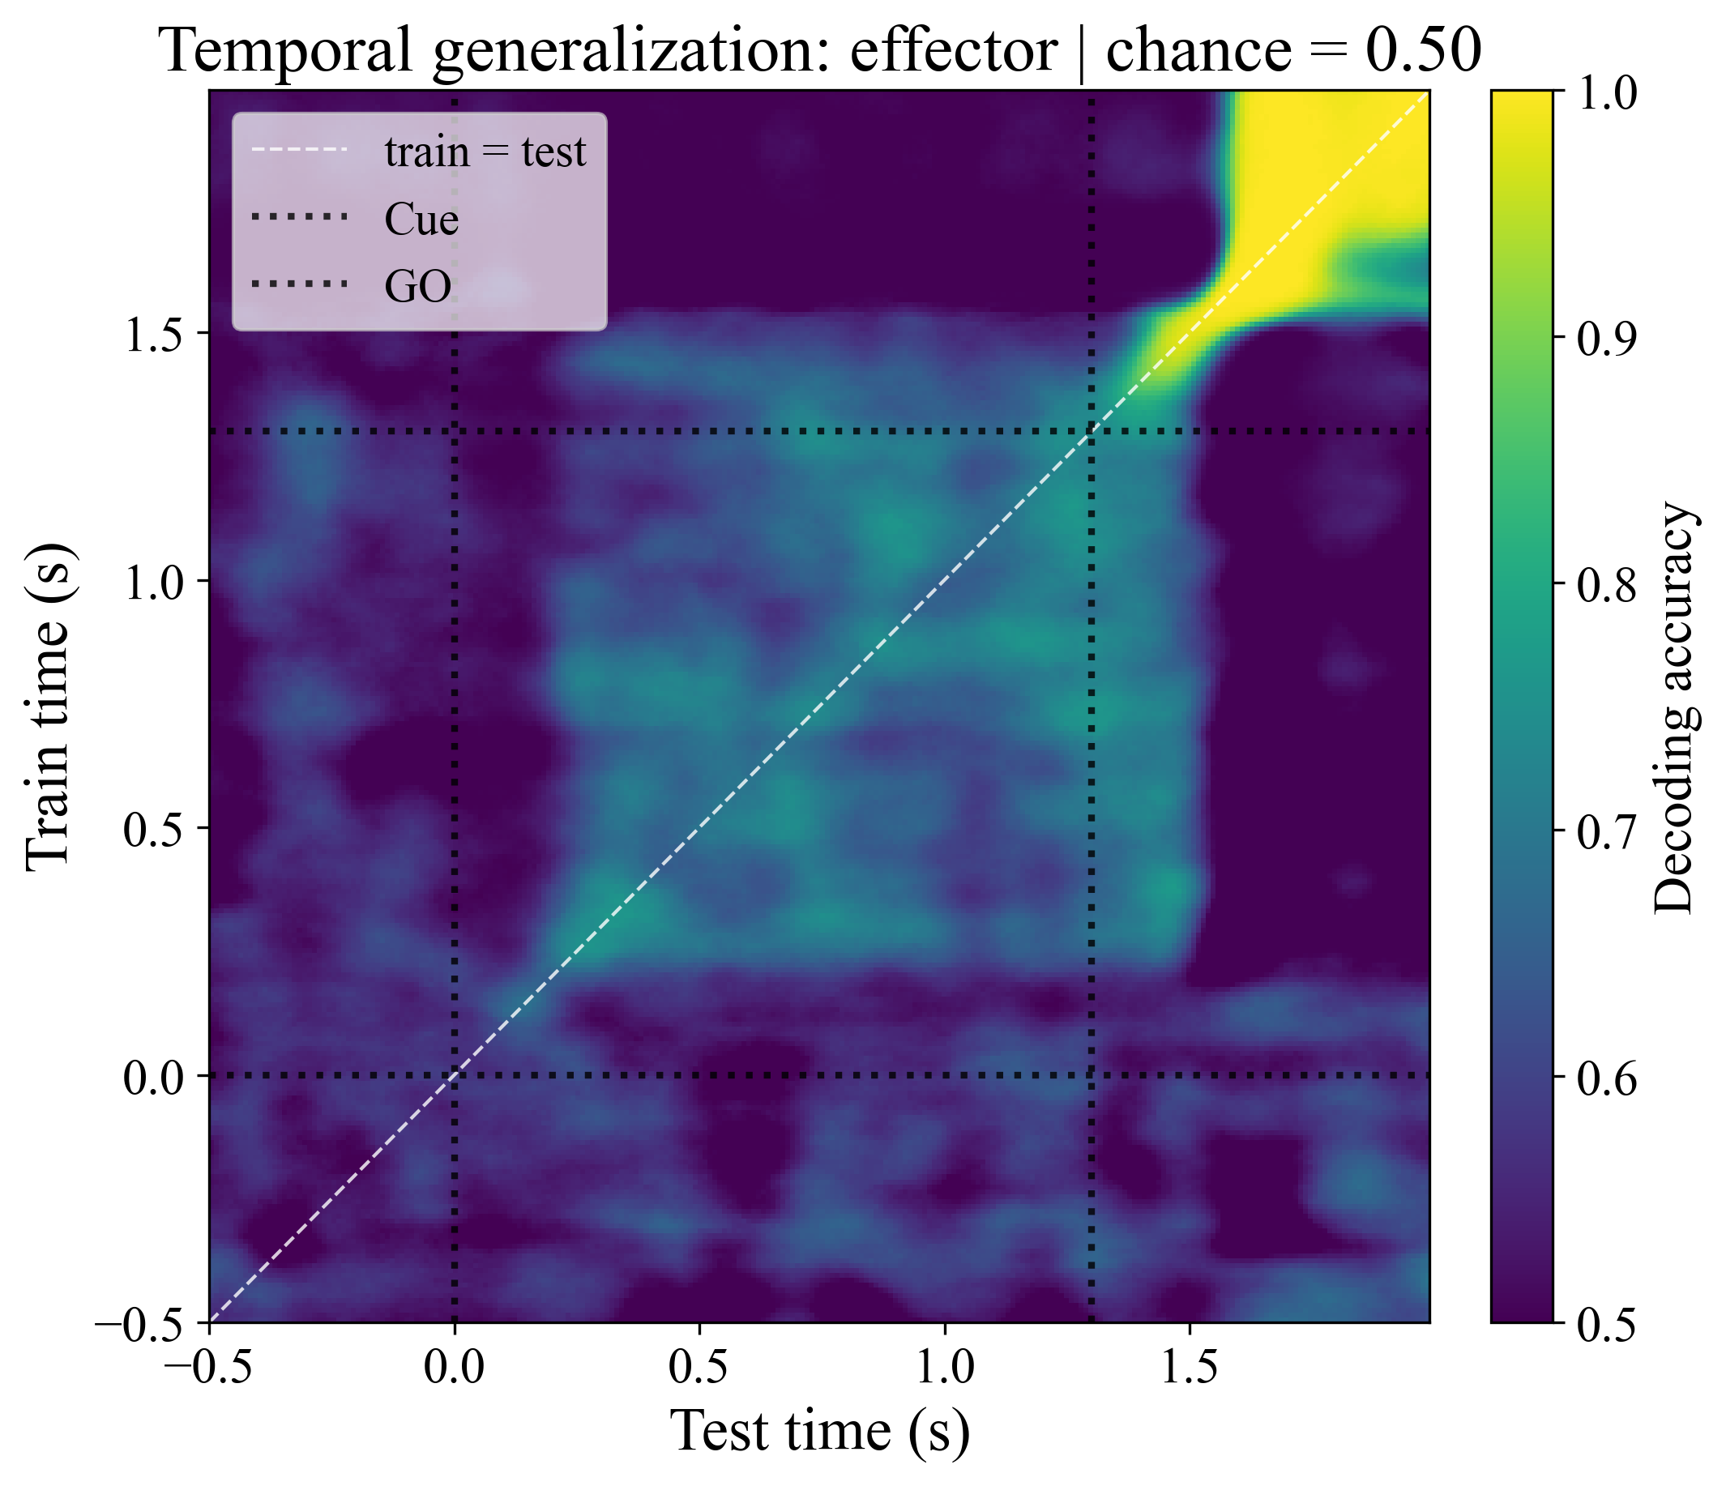
Time-resolved Decoding
Decoding: Predicting task variables using neural activity.
Task variables: Space, Hand, Effector
Can dorsal pulvinar activity predict whether the target was ipsilateral or contralateral?
We use logistic regression at each time point and predict for every time point. This gives Temporal Generalization Matrices.
Ref: (8)
Notes:
So here we try to predict the task variables from the activity of all units and for this we use logistic regression.
We model it at each time point and try to predict these variables at every time point.
This gives us what is called a Temporal Generalization Matrix.
As an example, here we try to predict the target location, whether left or right.
So we train the model right after the cue, it is very good, but it is not generalizable to other test times.
This gives us somewhat clean areas to designate as cue, planning and execution that we in the next step.

Slide 9
Targeted Dimensionality Reduction (TDR)
Neural activity lives in a high-dimensional state space
Each axis represent one neuron’s firing rate
We represent neural dynamics as neural trajectories
TDR:
TDR Axis: Space
$$rate\left(unit, t\right)=β_{0}+β_{1}\left(Space\right)+β_{2}\left(Hand\right)+…$$
TDR Axis: Hand
The Beta vector for a task variable gives the direction for that variable.
Löwdin symmetric orthonormalization to get independent directions. Minimize distance between raw and output axes.
Then we project the trajectories to the TDR axes.
Ref: (9)
Notes:
Now we look at the inverse, which is encoding using TDR. It is about how task variables are represented in the neural activity.
Which lives in a high-dimensional state space where each axis represent one neuron’s firing rate
We predict the neural activity for each unit using the task variables.
We put the Beta values into a vector and that gives the direction for that variable.
We can get the TDR axis for each for our task variables and we orthogonalize them.
Then in the final step, we project the trajectories onto these axes.

Slide 10
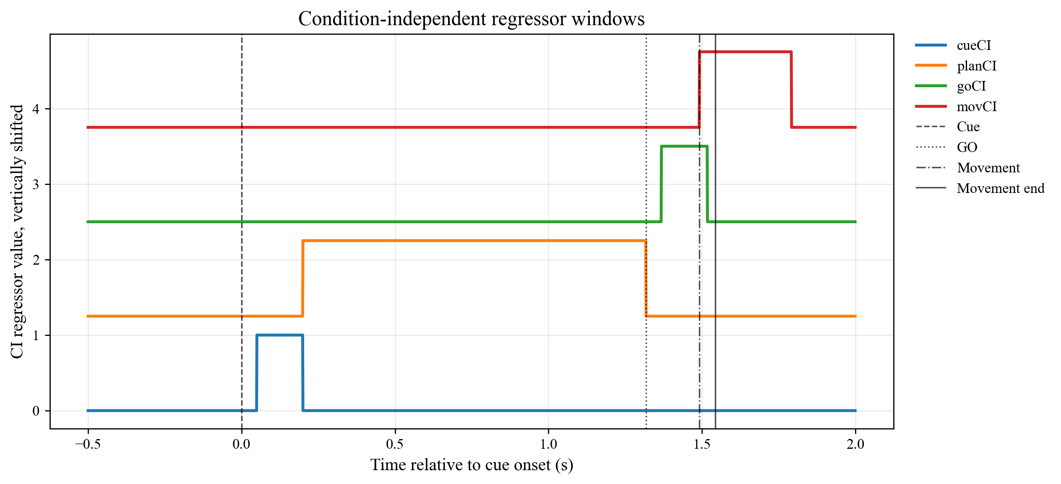
Targeted Dimensionality Reduction: Defining Regressors
4 event-related Regressors: These capture activity not specific to a condition. Control variable.
1 Hand Regressor: Does activity distinguish ipsi vs contra hand?
2 Space Regressors: Continuous horizontal and vertical directions. Does activity distinguish ipsi vs contra targets?
3 Effectors: Saccade, Contralateral Hand, Ipsilateral Hand. Make horizontal or vertical = 6 regressors. Does activity distinguish ipsi vs contra targets when using saccades or when using contra hand?
Temporal Modulation: Space variables are made active only during CUE.
Effector variables are made active during planning and during movement = Double the regressors (12)
In total we have 19 regressors.
Notes:
But first, we need to properly define our regressors.
We use 4 event-related Regressors that capture activity not specific to a condition, just as control variables
We use a hand regressor
We use 2 space regressors for horizontal and vertical
We use 3 effectors, Saccade, Contralateral Hand, Ipsilateral Hand which are made specific to horizontal or vertical space
We also do temporal modulation where the space variables are made active only during CUE,
while the effectors are made active during both planning and movement
So to sum up, for each of these regressors, we will get one axis in the state space. Then we can project the neural trajectories onto that axes.

Slide 11
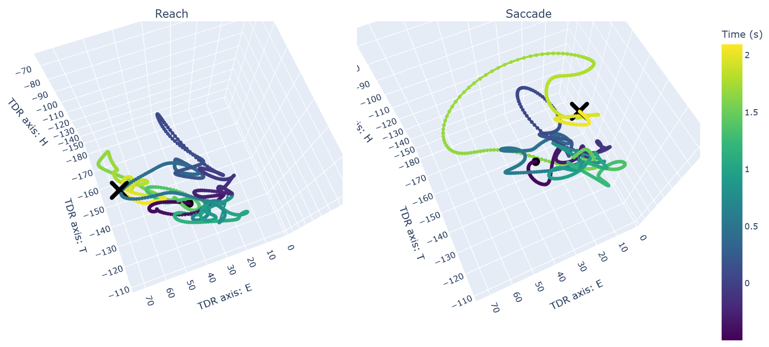
Targeted Dimensionality Reduction: Results
Notes:
We first looked at some 3D plots to orient ourselves, but these can be unintuitive to look at

Slide 12
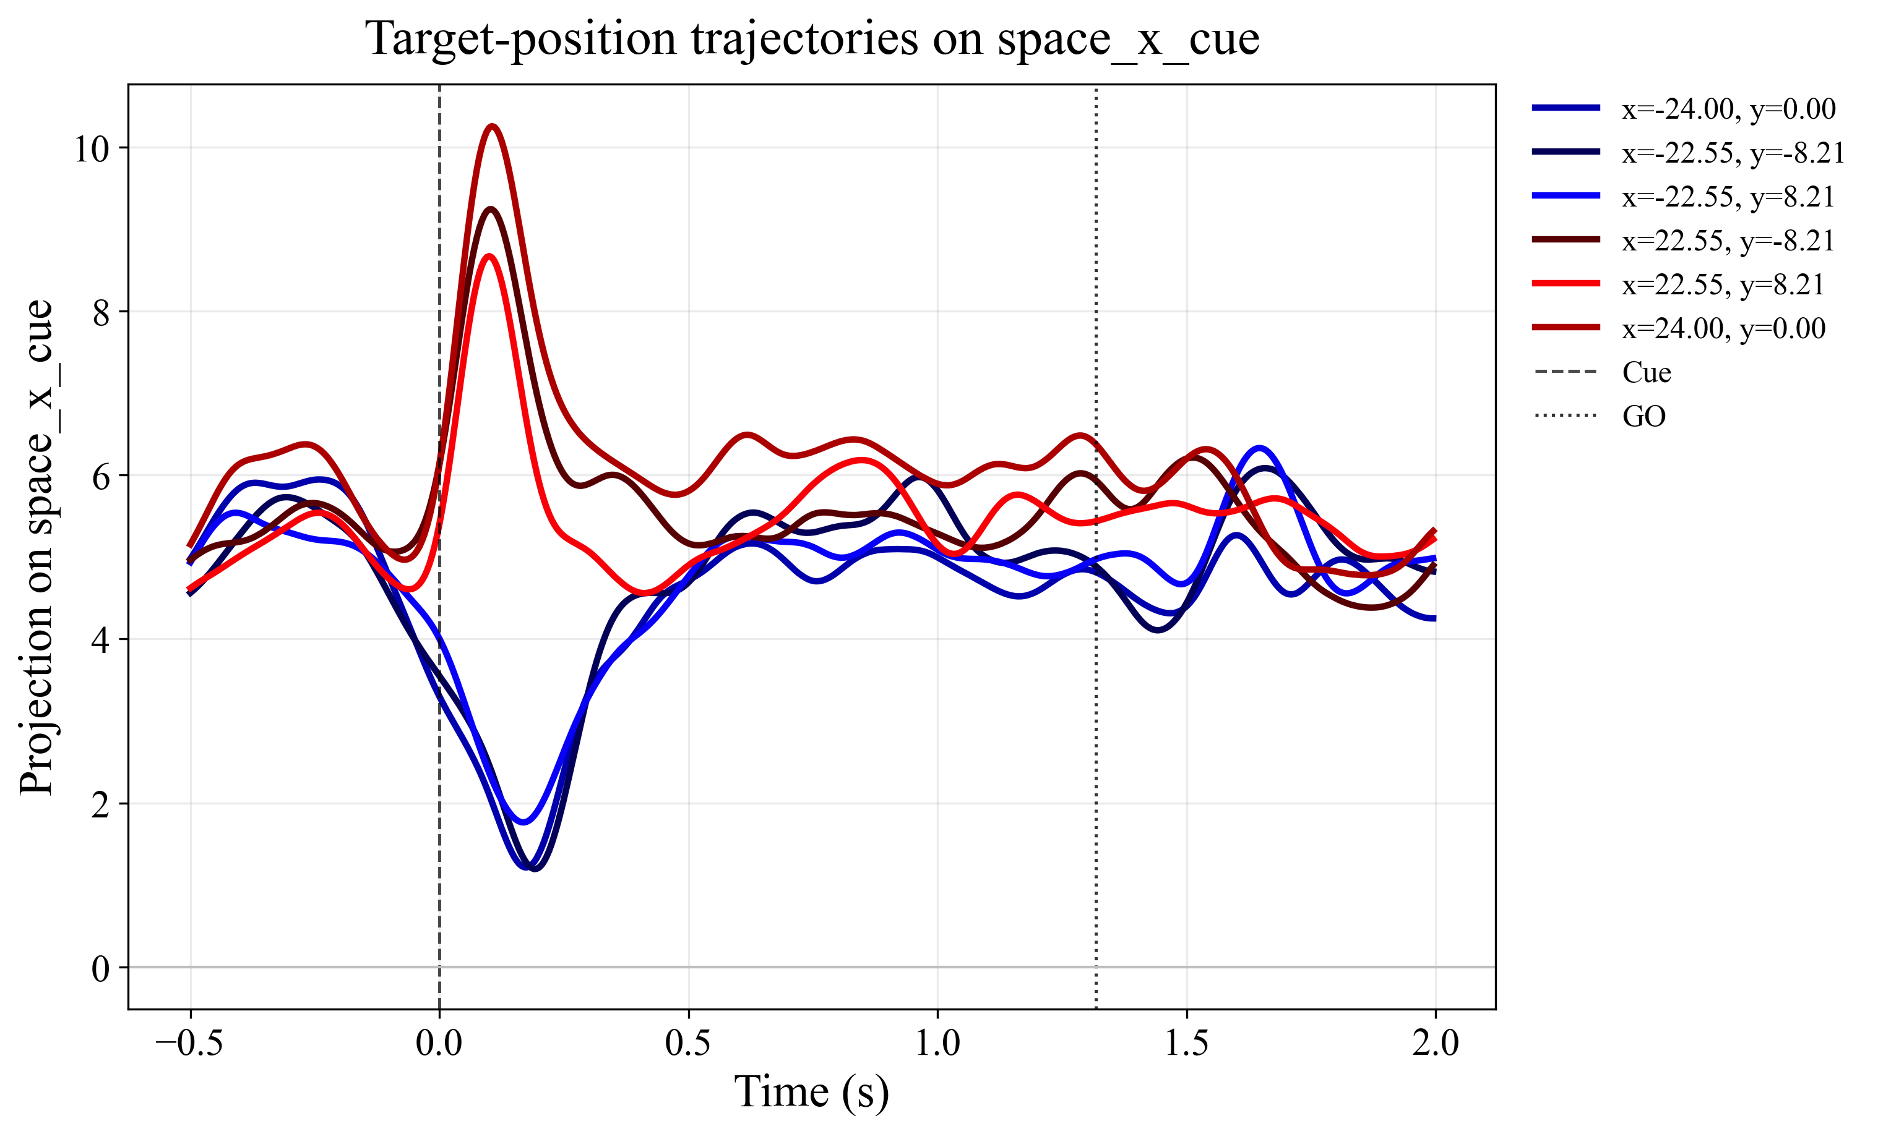
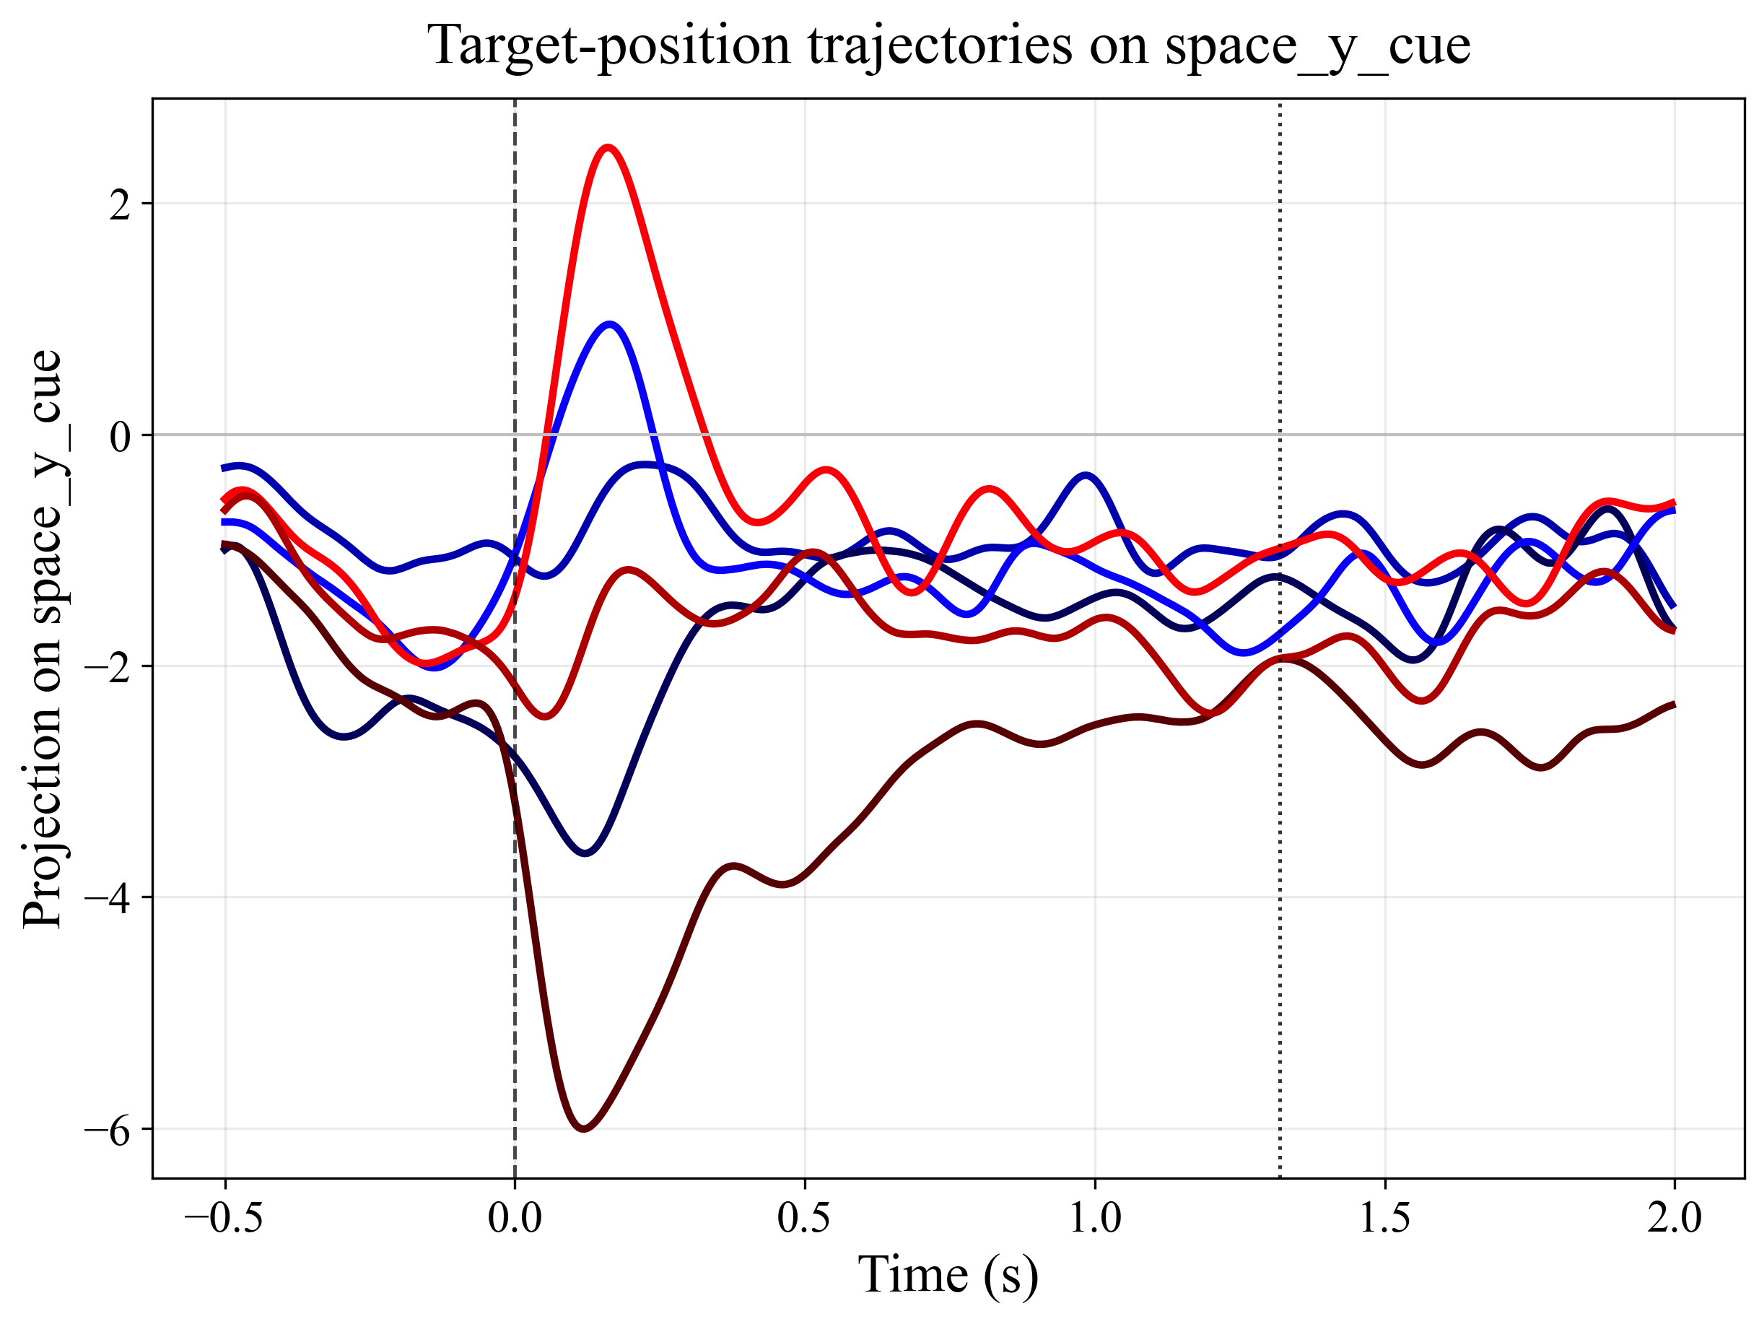
Targeted Dimensionality Reduction: Space encoding
Reds: Contra
Blues: Ipsi
Contralateral space bias in encoding
Notes:
We start with the space encoding axes that we made active only around the cue.
For the horizontal axis, we see a clear separation of the ipsilateral and contralateral space around the CUE.
For the vertical direction, we see that it separates on the contralateral side, but not so much the ipsilateral side.
So what we see here is a bias to encode for contralateral space, which is expected from previous studies.
What we still don’t know is if the bias is for salience or for voluntary action.

Slide 13
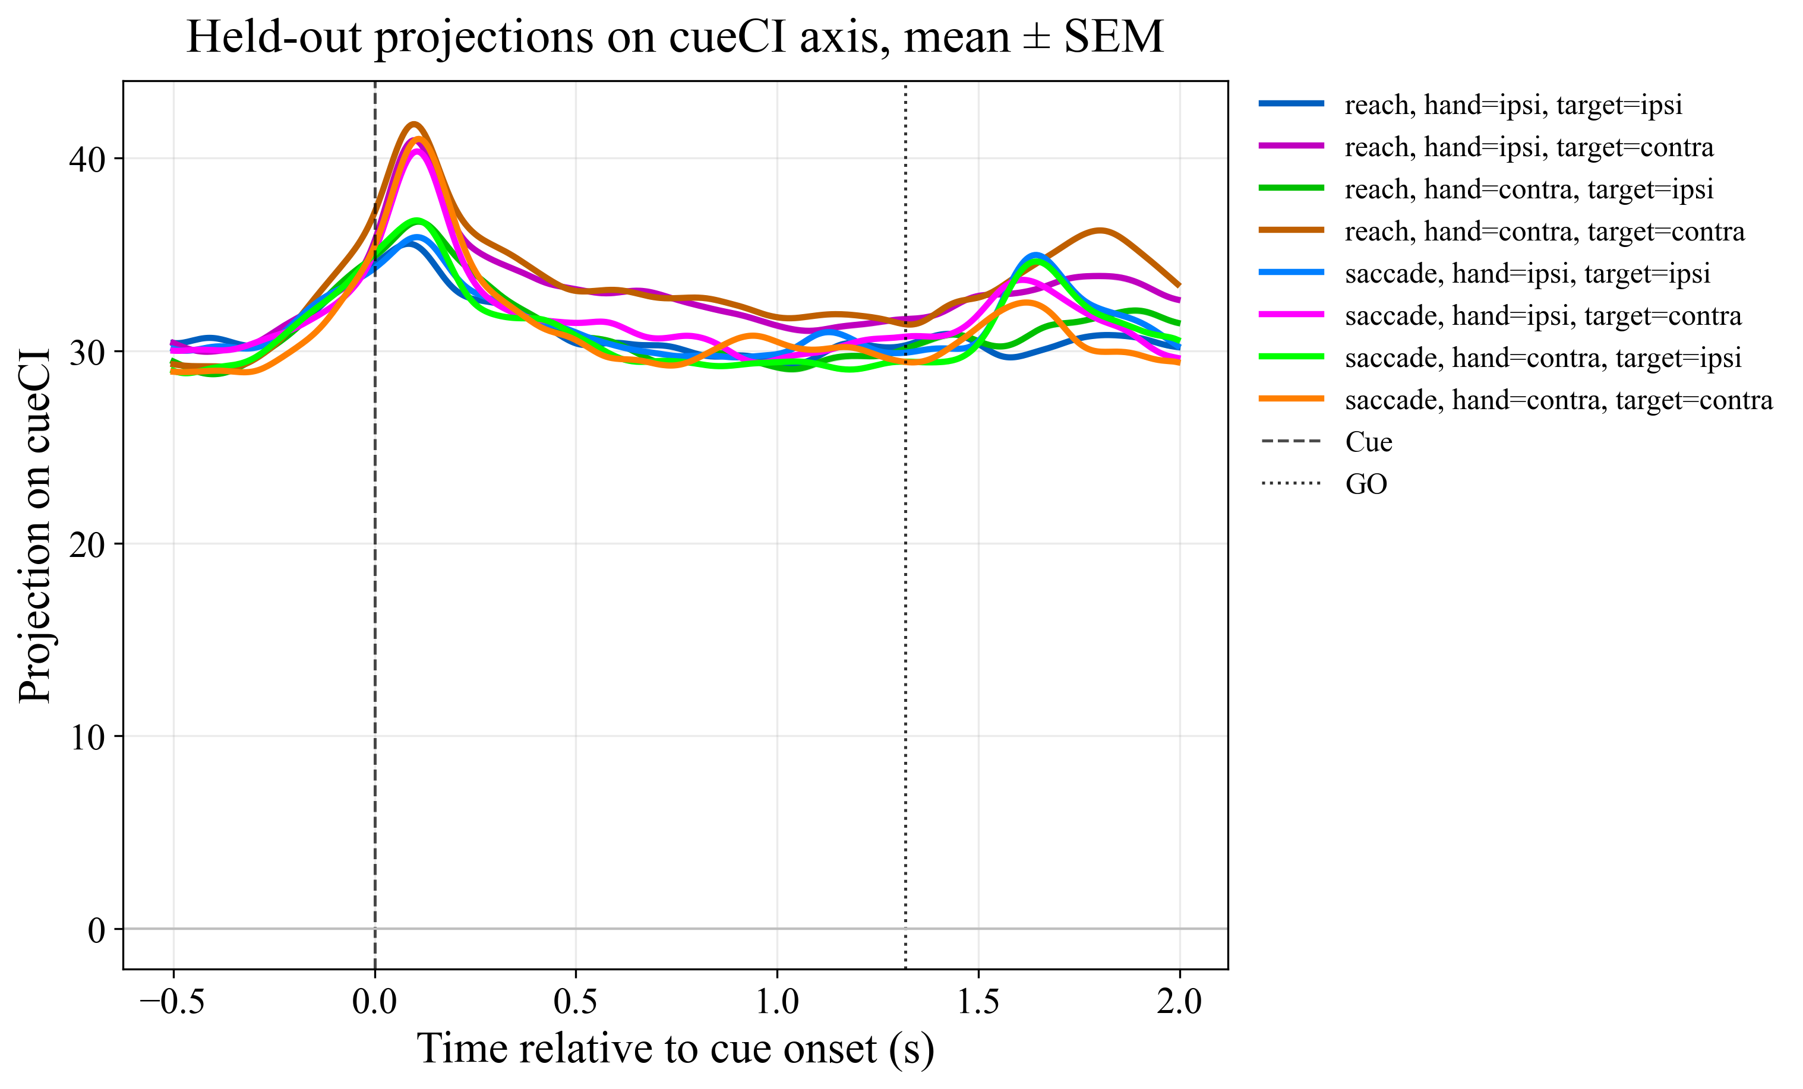
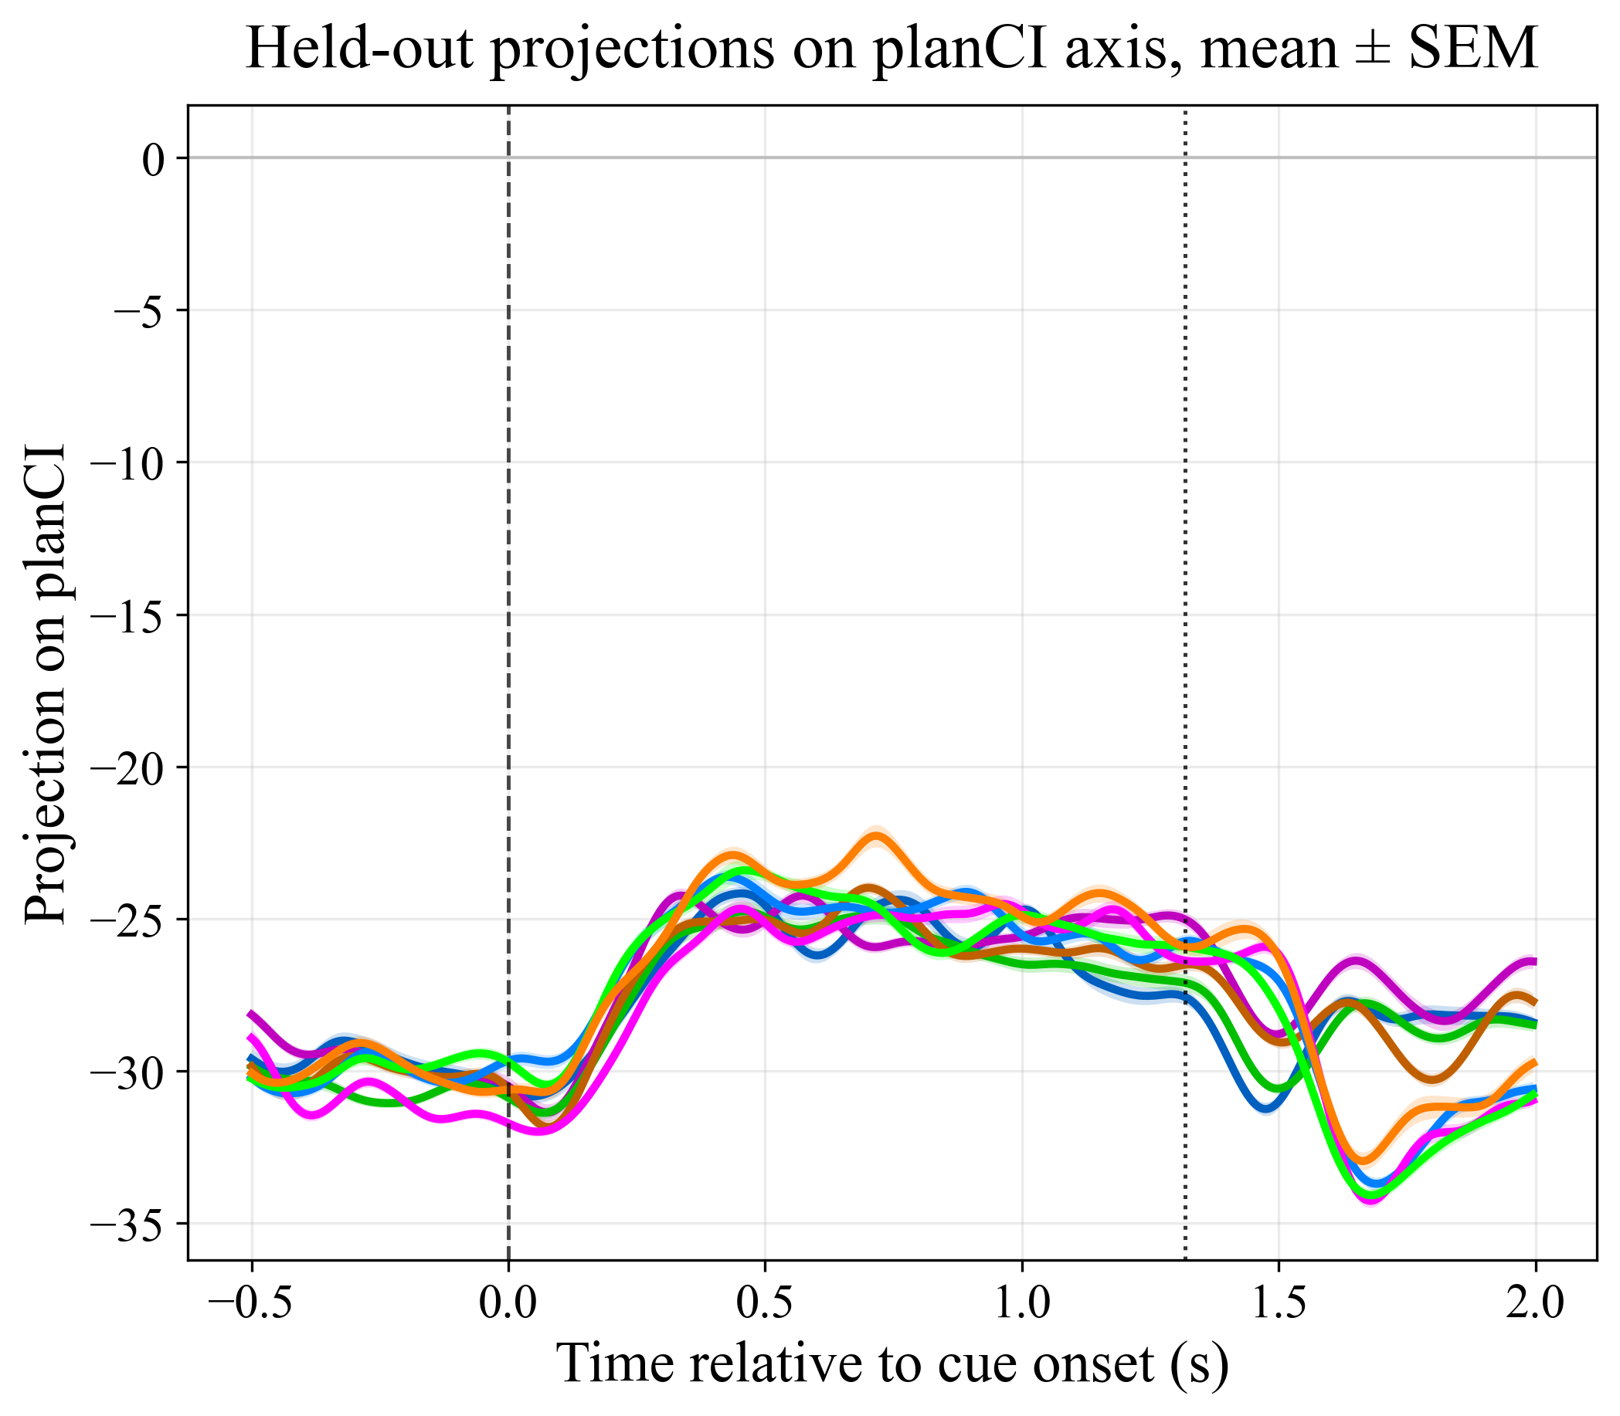
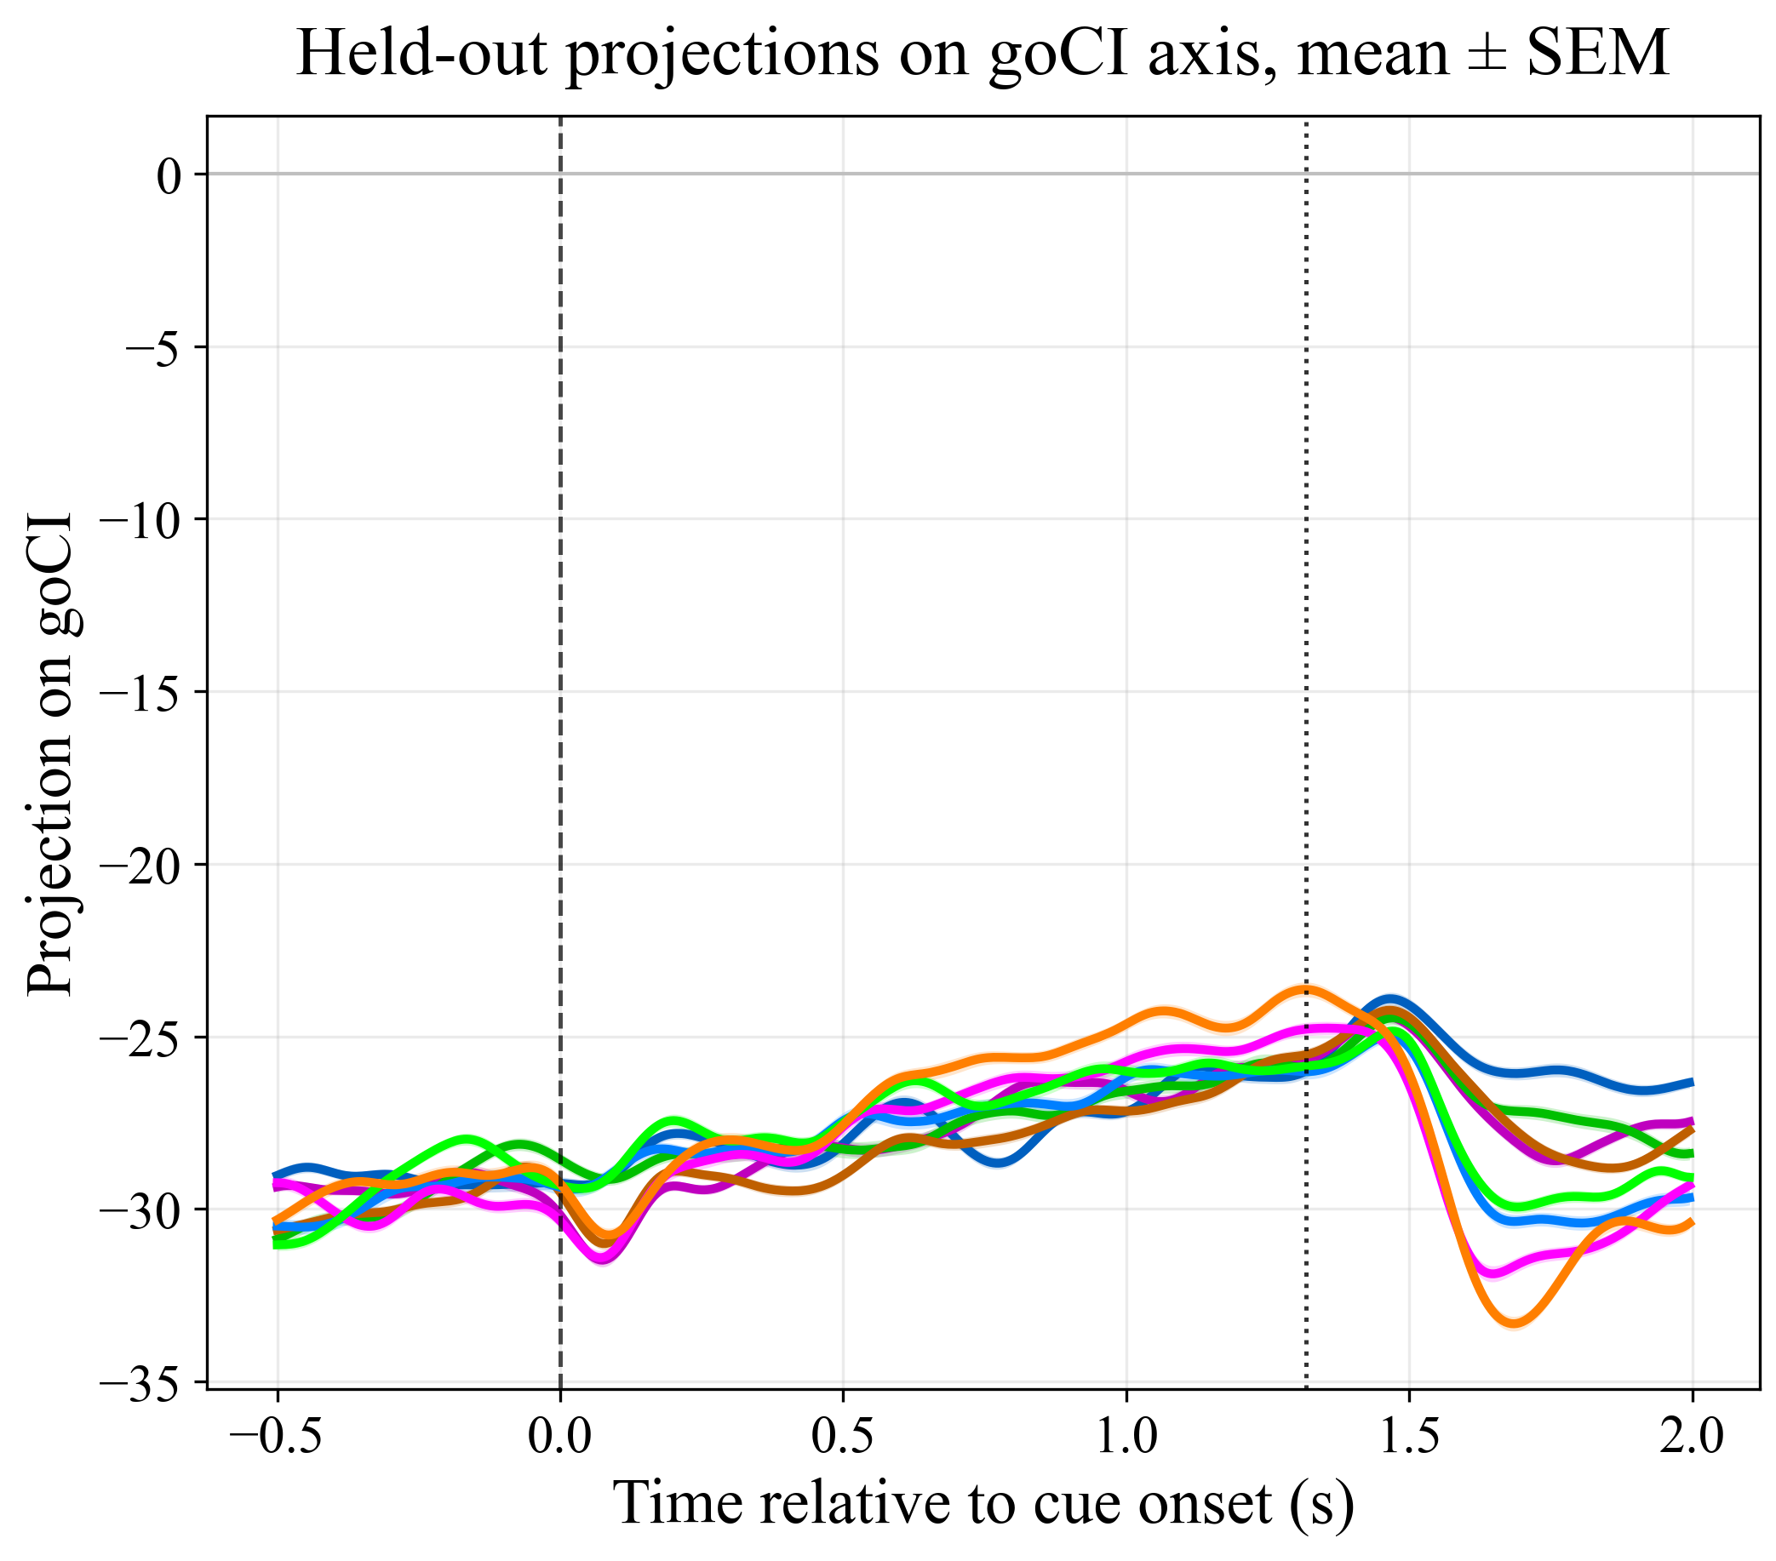
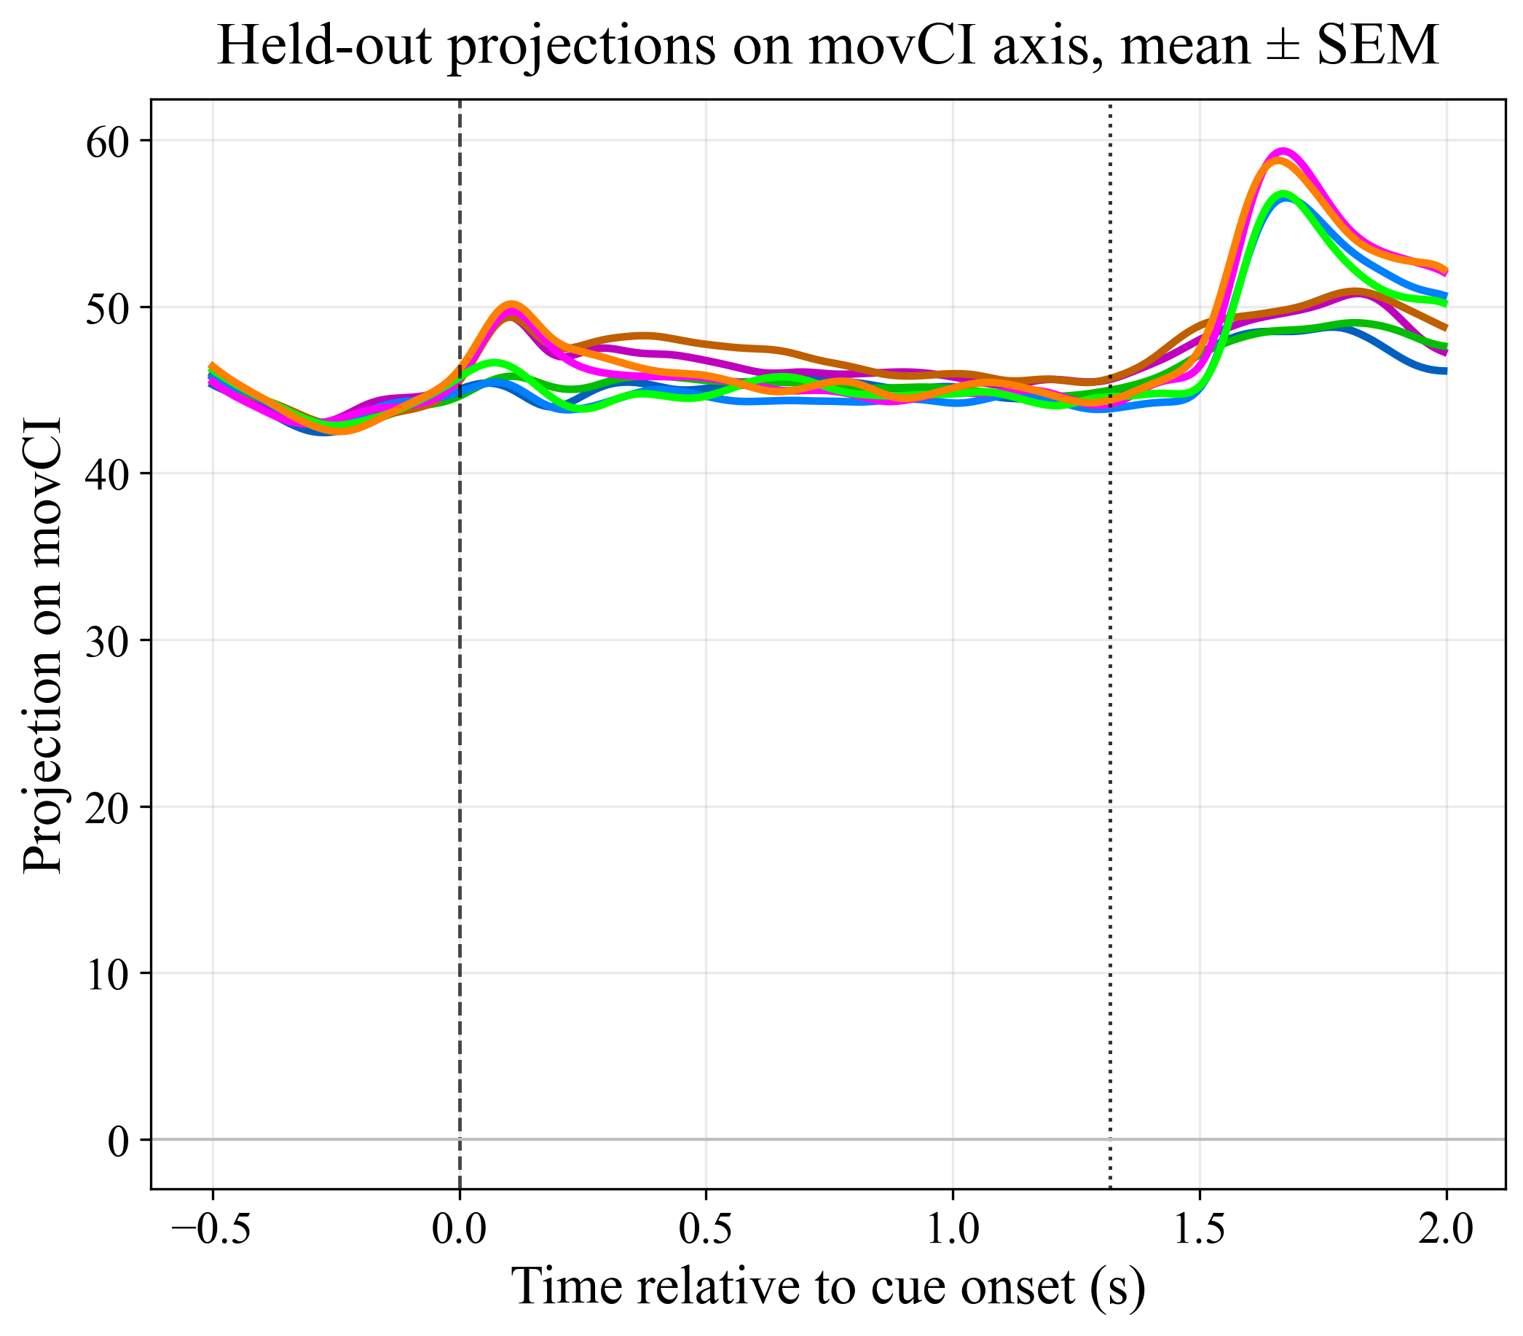
Targeted Dimensionality Reduction: CI axes
Notes:
These are the condition-independent axes. Here, we see that we can find a subspaces that encode for general increase or decrease of activity due to the timing of events. Basically we want to control for these general activations.

Slide 14
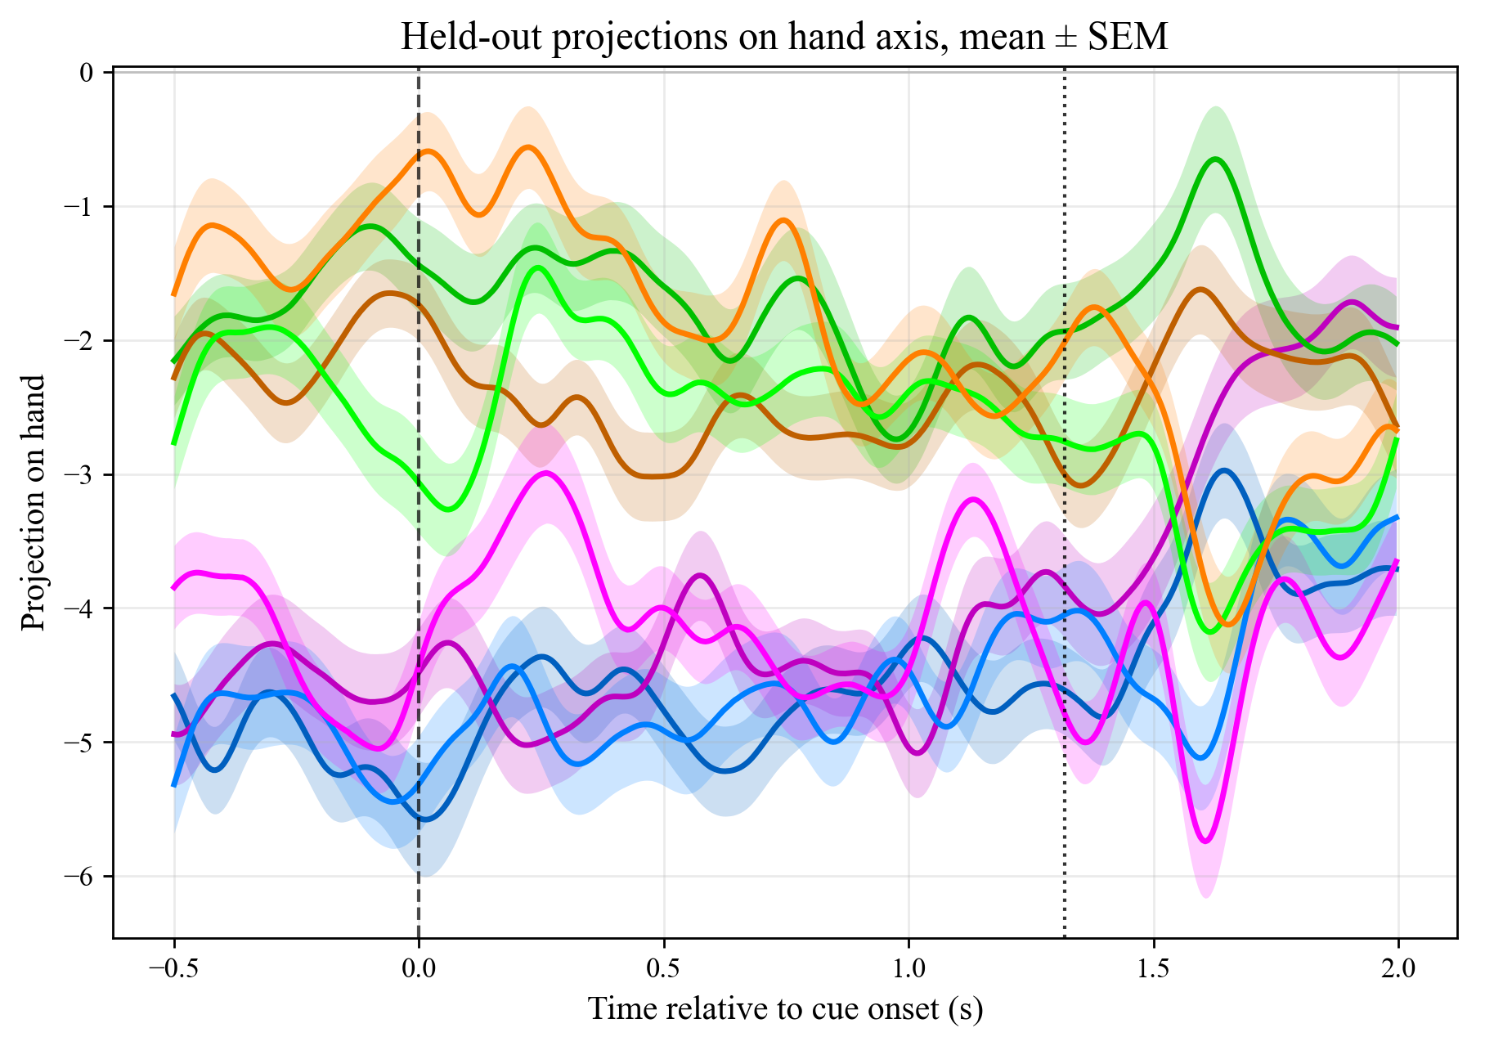
Targeted Dimensionality Reduction: Hand encoding
Contra and Ipsi defined by recorded pulvinar side
Notes:
Now we come to the hand axes. There are 8 trajectories here corresponding to the combination of effector, hand and space.
We see a clear separation between the trajectories for the contra and ipsi hand.
This even exists before the CUE and also for saccade trajectories, so we interpret this as explaining postural effect of hand.
So the pulvinar seems to encode for hand even when it is not actively in motion.

Slide 15
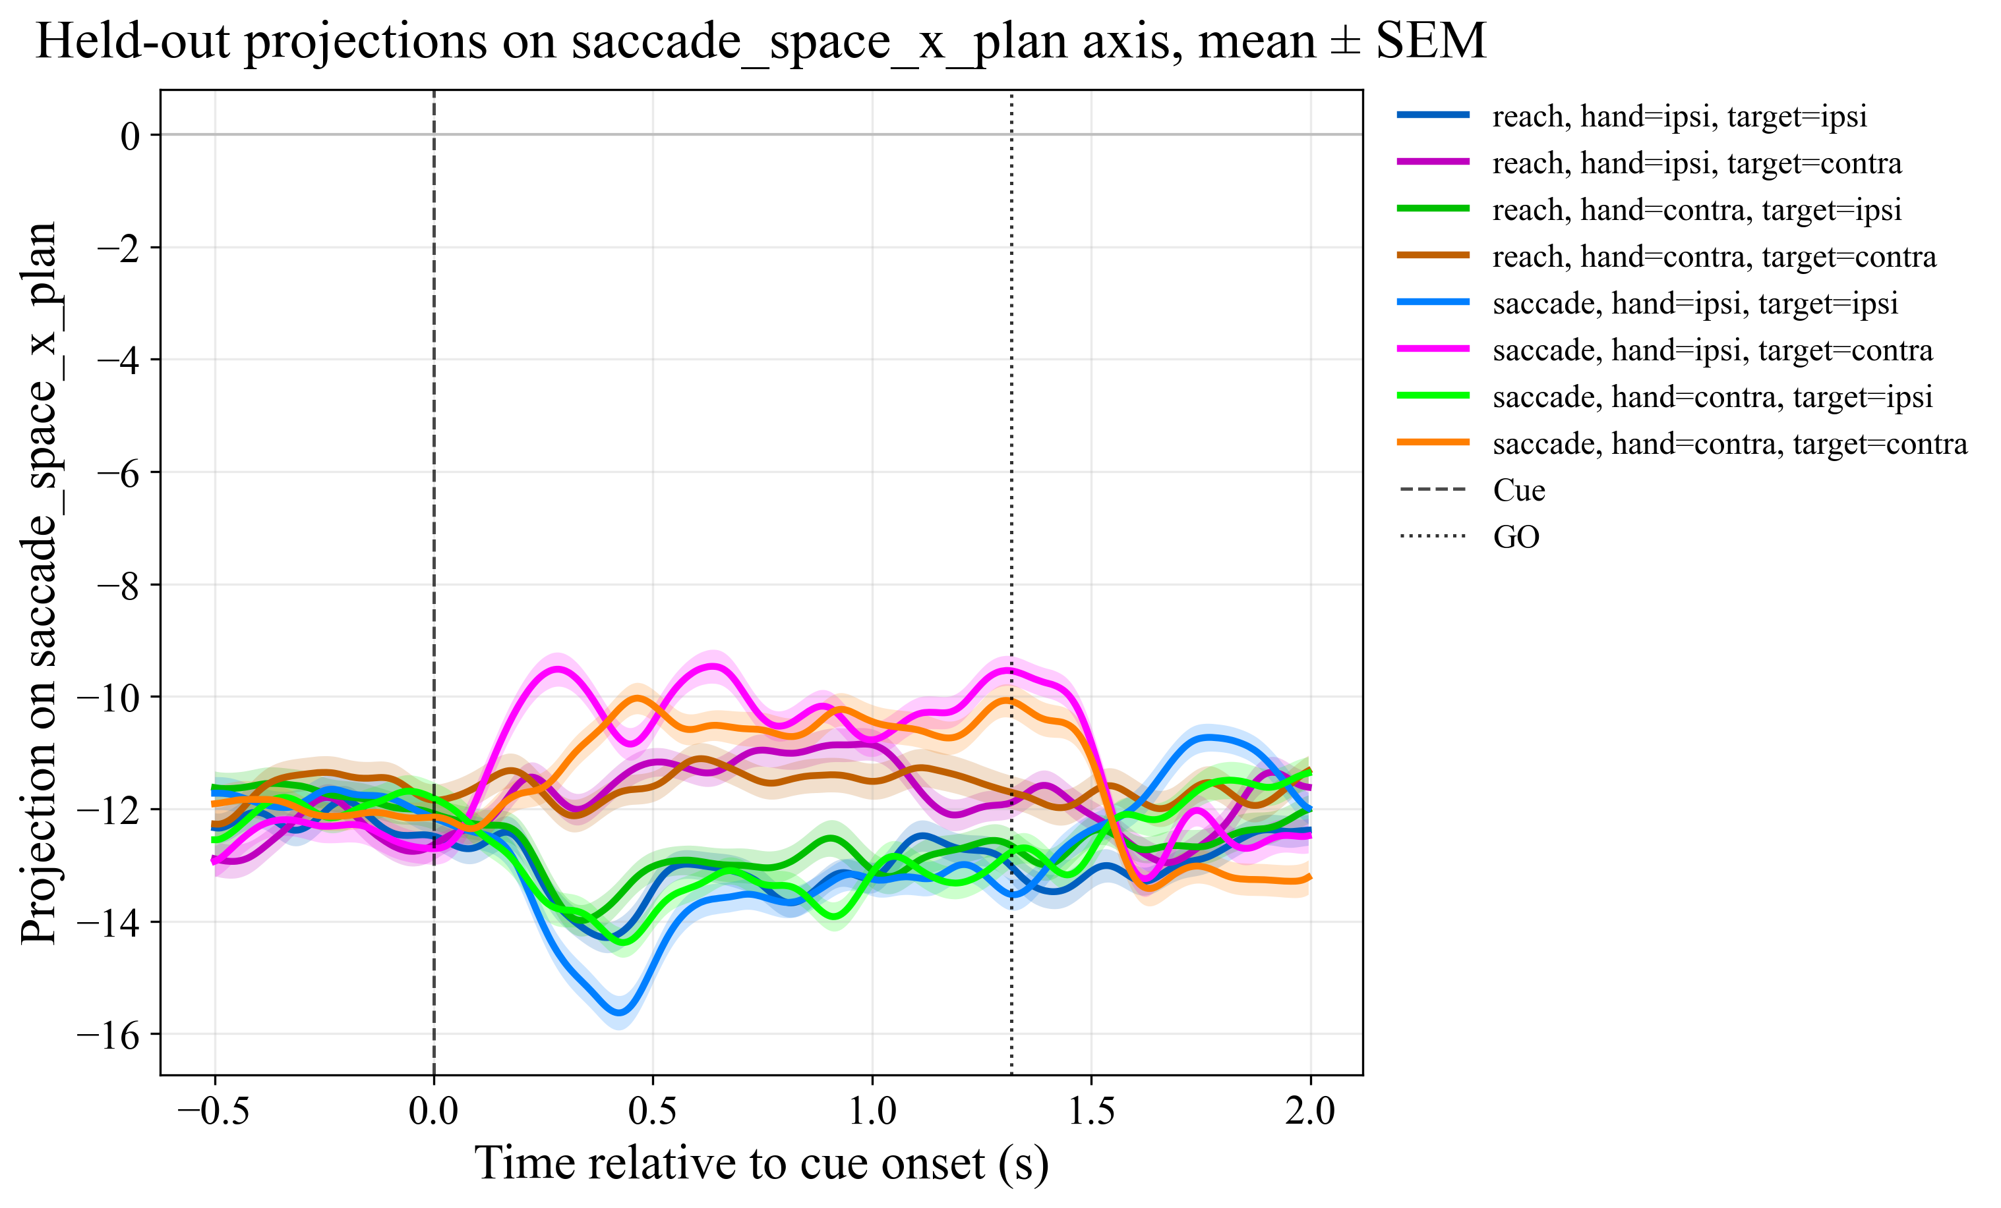
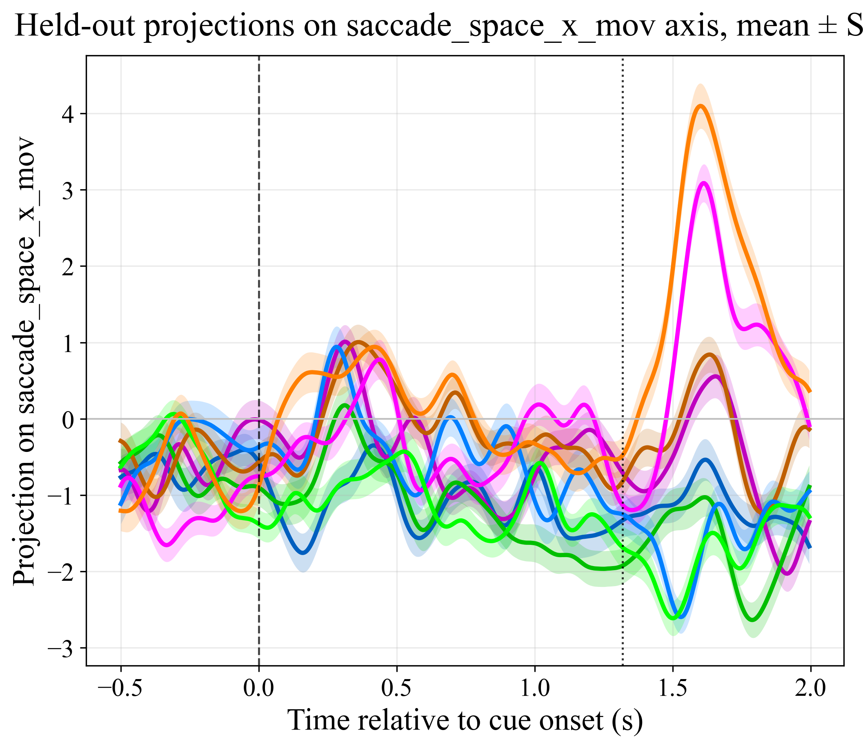
Targeted Dimensionality Reduction: Saccade encoding
Notes:
Now looking at saccade axes along the horizontal direction, we have two independent axis for planning and movement.
In planning, we see a separation of not only saccades which is expected but also of reaches
This means that TDR was not able to find a pattern of activity in the dorsal pulvinar that specifically encodes saccades during planning.
So the pulvinar seems to not encode for saccades during planning. But it does do so during movement.

Slide 16
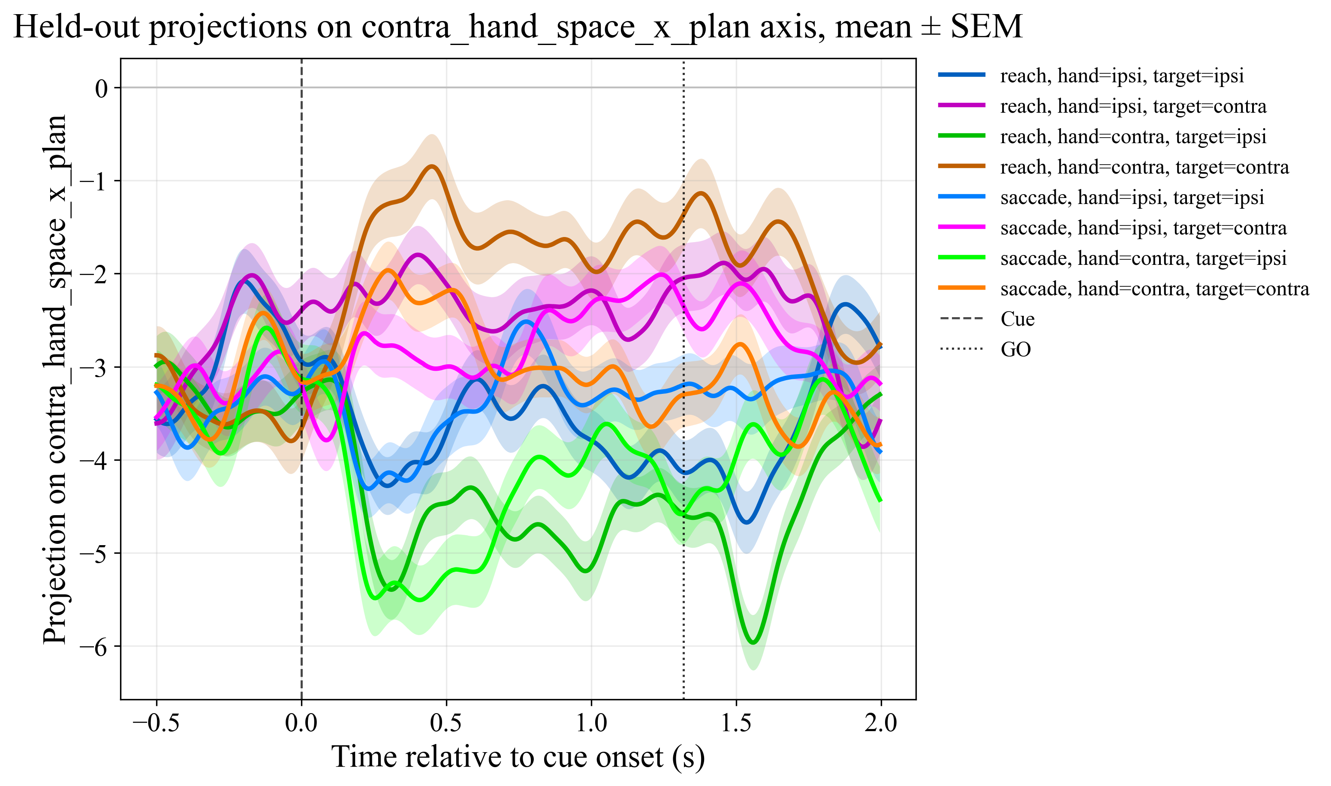
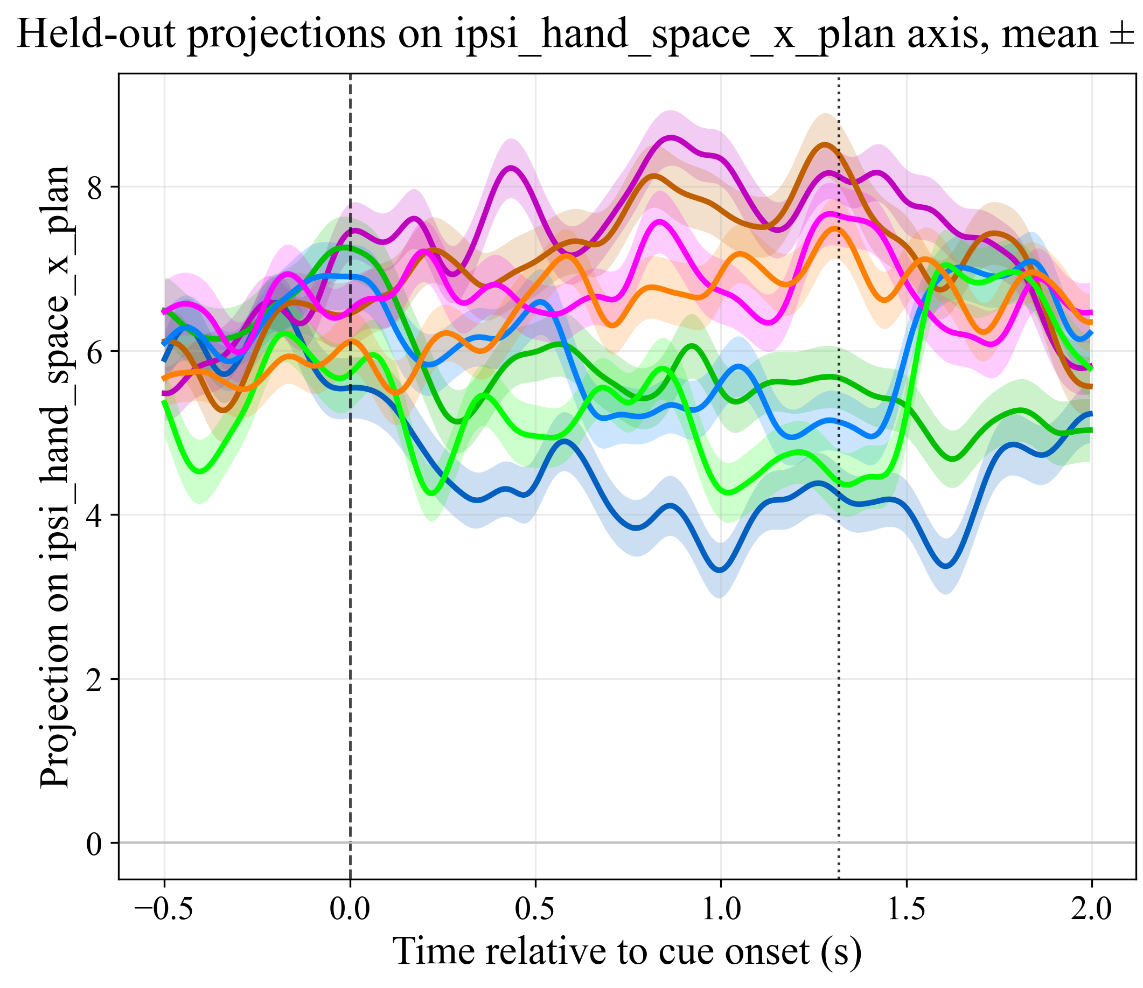
Targeted Dimensionality Reduction: Hand Planning
Notes:
Now what about reaches during planning. Here, we also see that although the axis is meant to only separate the reach conditions, it is not able to do so.
So the planning results might indicate that the pulvinar encodes for planning in space in a general sense
To speculate a bit, it might be encoding for general sense of goal or attention, where do I need to be, but not which effector should I use.

Slide 17
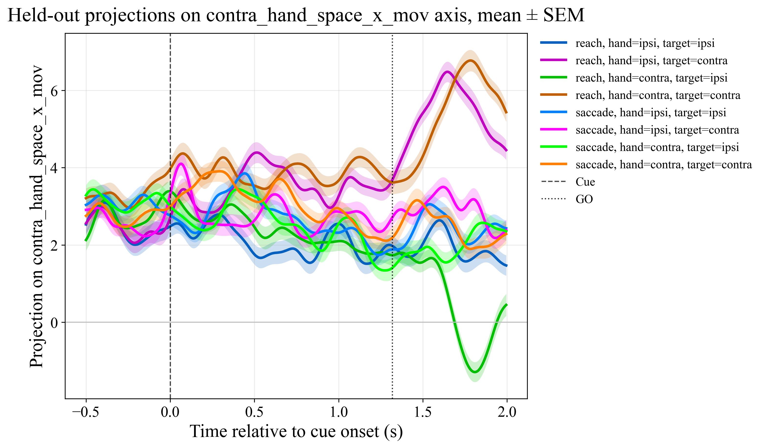
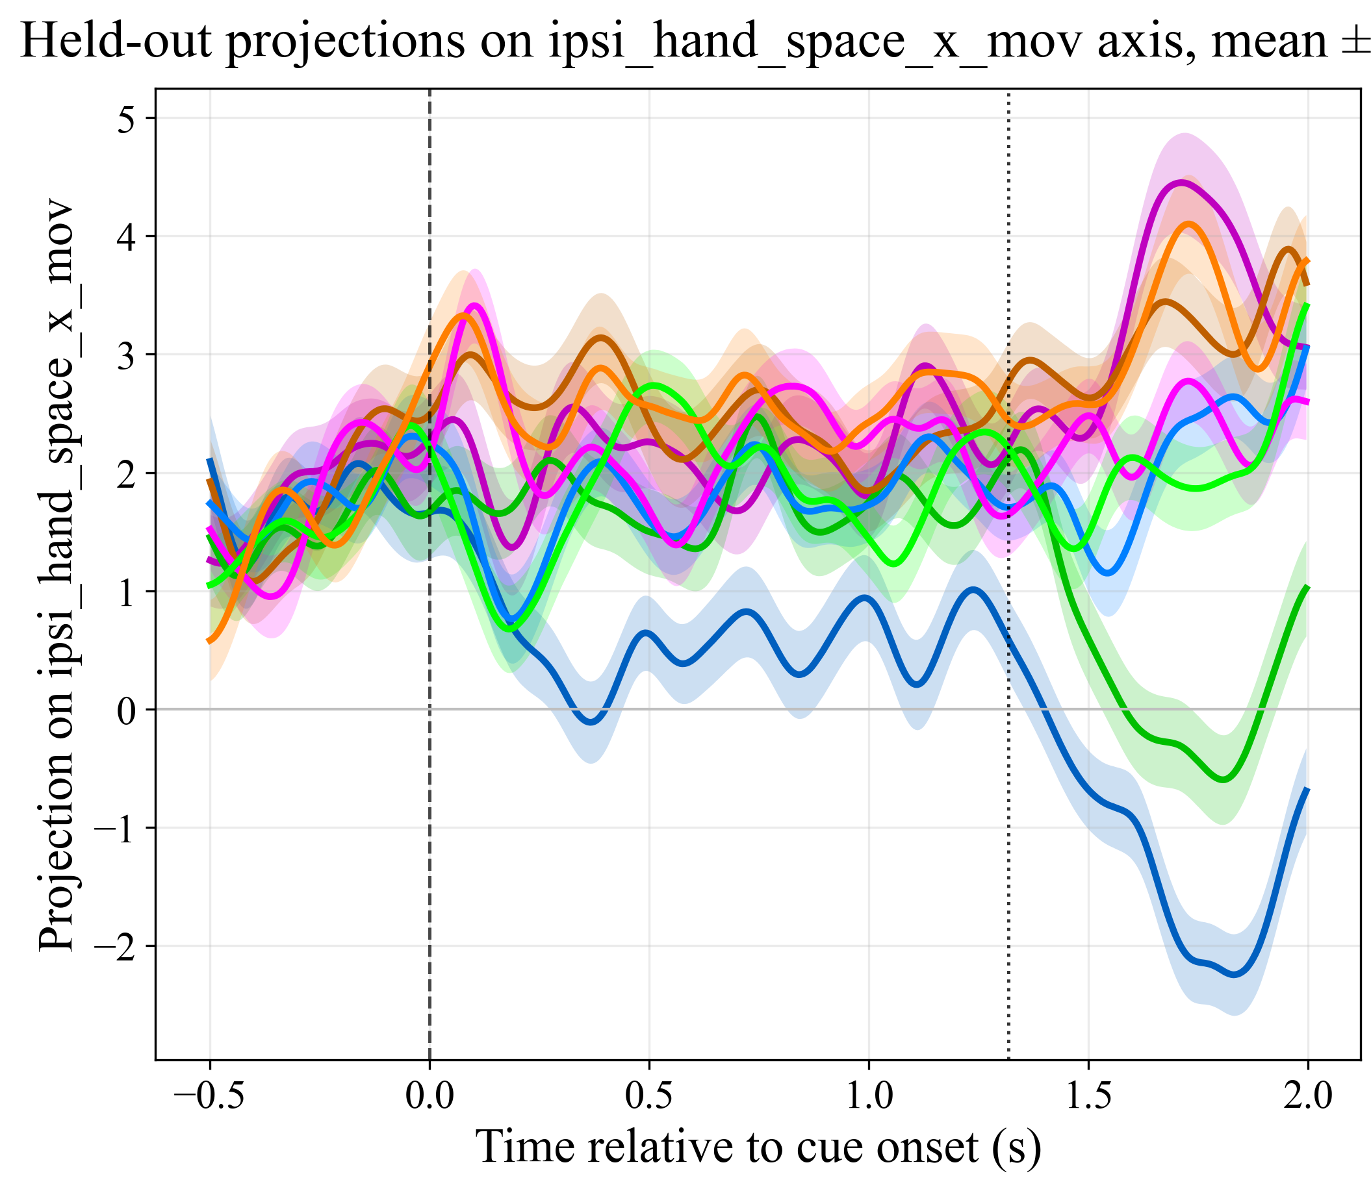
Targeted Dimensionality Reduction: Hand Movement
Notes:
Now the last set of plots, for hand encoding during movement, we do some clear signal.
We do see the separation between the brown and green trajectories.
But interestingly, we also see a signal for ipsilateral hand, only during reaches to the opposite space.
There is a clear asymmetry and we are still figuring out what that could mean.

Slide 18
Discussion and Future Directions
Problems:
This still need statistics, quantification
Generalizes for two monkeys, need more
No causal information, so hard to say concretely about function
Like GLM in fMRI, TDR interpretation depends heavily on the way we define the regressors
Future directions:
Implementing the state-space analysis in Parietal and Frontal motor regions. We already have recordings.
  Communication Subspace (10)
Causal studies, inactivating the dorsal pulvinar, and connecting regions (11)
$$rate\left(area 1 unit\right)=β_{0}+β_{1}rate(area 2 unit)+…$$
Notes:
There are several things we still need to look at.
First we need proper quantification of these trajectories and differences between them and do some statistics on them.
Only then we can be more conclusive.
Next, we can do similar analysis for parietal and frontal regions. And we can use the idea of communication subspace.
The idea is that we can instead predict the activity of one region from another region. And the beta here, give us a communication subspace.
Then we can quantify the angles between this subspace and the task axes.

Slide 19
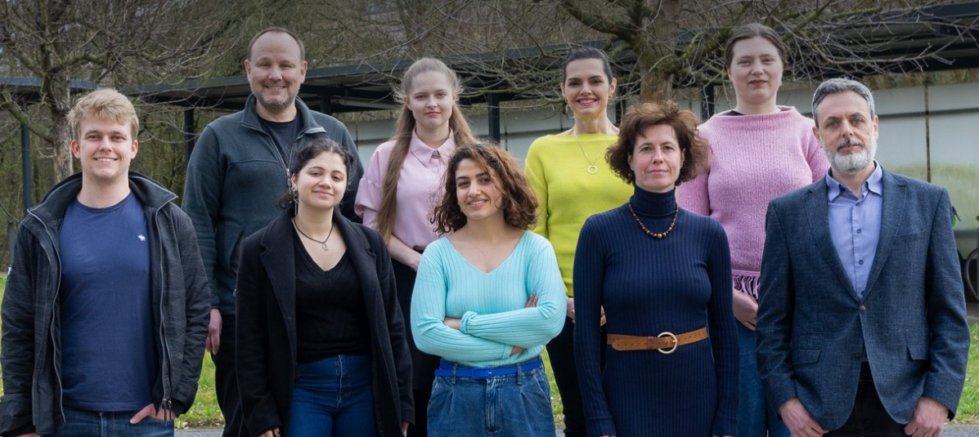
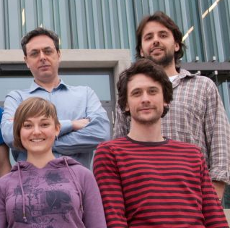

Thank you and Questions!
Dr. Igor Kagan
Dr. Lukas Schneider
Dr. Benjamin Dann
Notes:
Now I would like to thank the people at the DAG
And now open to questions.

Slide 20
References
Goodale, M. A., & Milner, A. (1992). Separate visual pathways for perception and action. Trends in Neurosciences, 15(1), 20-25.
Cisek, P., & Kalaska, J. F. (2010). Neural mechanisms for interacting with a world full of action choices. Annual review of neuroscience, 33, 269-98.
Wilke, Melanie & Kagan, Igor. (2023). Visuospatial and Motor Deficits Following Pulvinar Lesions. 10.1093/med/9780197676158.003.0071.
Shadlen, M. N., & Newsome, W. T. (1998). The variable discharge of cortical neurons: implications for connectivity, computation, and information coding. The Journal of neuroscience : the official journal of the Society for Neuroscience, 18(10), 3870–3896. https://doi.org/10.1523/JNEUROSCI.18-10-03870.1998
Fusi, S., Miller, E. K., & Rigotti, M. (2016). Why neurons mix: high dimensionality for higher cognition. Current Opinion in Neurobiology, 37, 66-74.
Tye, K. M., Miller, E. K., Taschbach, F. H., Benna, M. K., Rigotti, M., & Fusi, S. (2024). Mixed selectivity: Cellular computations for complexity. Neuron, 112(14), 2289-2303.
Rigotti, M., Barak, O., Warden, M. R., Wang, X.-J., Daw, N. D., Miller, E. K., & Fusi, S. (2013, May 01). The importance of mixed selectivity in complex cognitive tasks. Nature, 497(7451), 585-590.
King, J.-R., & Dehaene, S. (2014). Characterizing the dynamics of mental represen tations: the temporal generalization method. Trends in Cognitive Sciences, 18(4), 203-210.
Mante, V., Sussillo, D., Shenoy, K. V., & Newsome, W. T. (2013, Nov 01). Context dependent computation by recurrent dynamics in prefrontal cortex. Nature, 503(7474), 78-84.
Semedo, J. D., Zandvakili, A., Machens, C. K., Yu, B. M., & Kohn, A. (2019). Cor tical areas interact through a communication subspace. Neuron, 102(1), 249 259.e4.
Kaduk, K., Wilke, M. & Kagan, I. Dorsal pulvinar inactivation leads to spatial selection bias without perceptual deficit. Sci Rep 14, 12852 (2024). https://doi.org/10.1038/s41598-024-62056-5

